Slide 1
District :
School :
Teacher :
The theme : “ Use of game elements in English language lessons in primary schools”

Slide 2
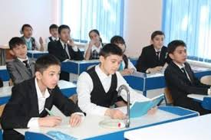
Content
I . Introduction
Why use games ?
II. Main part
Tasks of teaching English in primary
Some advice
Motivational games for children
III. Conclusion
IV. References

Slide 3
Why use games ?
Games provide children a break and at the same time allow them to practice language skills
Games are very motivating and amusing. At the same time it is also challenging
Games create meaningful and useful contexts for language use

Slide 4
Tasks of teaching English in primary
Arousing children’s interest in the language
To educate modern education of the individual
development of creative abilities of children

Slide 5
Some advice
Supplementary activities
Appropriacy
Clear instructions
No interruption and no correction during the game
No force
Stop the game if it’s tiring or boring

Slide 6
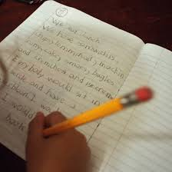
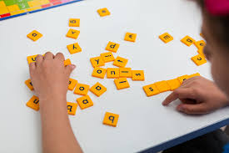
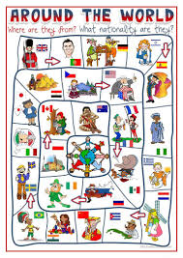
Motivational activities for children
“Around the world ”
“ Word jumble race”
“what’s in the bag ?”
“ Picture dictation”

Slide 7
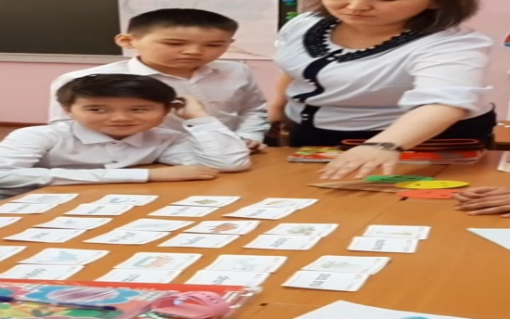
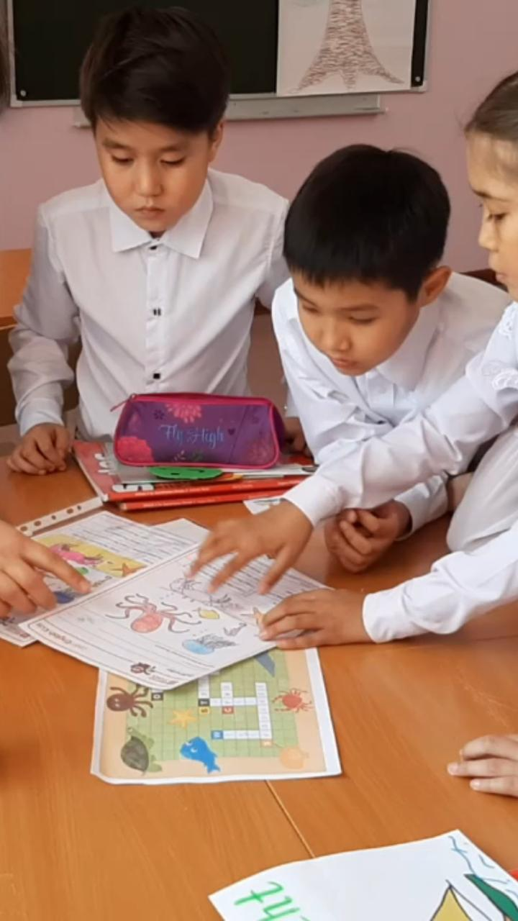
In my experience
“Picture Dictation”
“ Word jumble race”
“Team mime ”

Slide 8
Conclusion
As conclusion , learning English through games is an effective and interesting way that can be applied in any classrooms.
Games are used not only for fun merely, but more importantly for the useful practice and review of language lessons to improve learners’ communicative competence.
When a game is to be conducted , the factors such as number of students, proficiency level,timing, learning topic, and the classroom settings should be considered.

Slide 9
Thanks for attention

