Slide 1
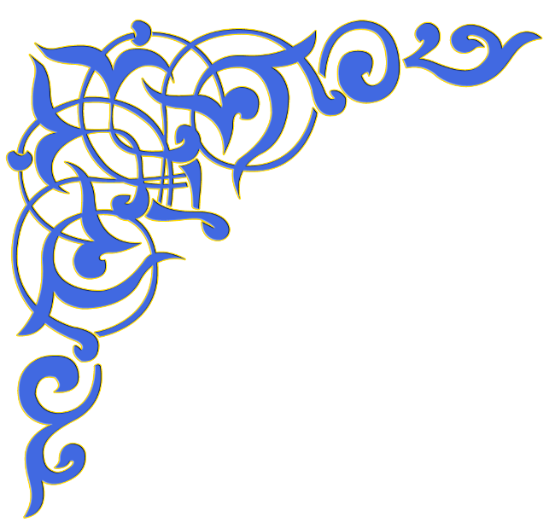
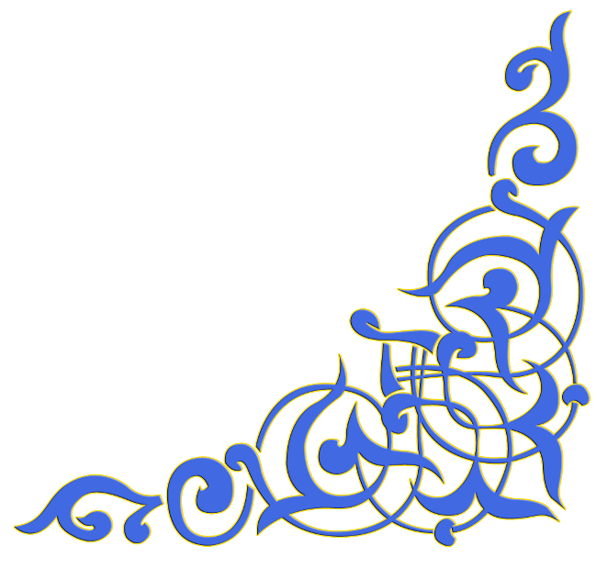

Slide 3
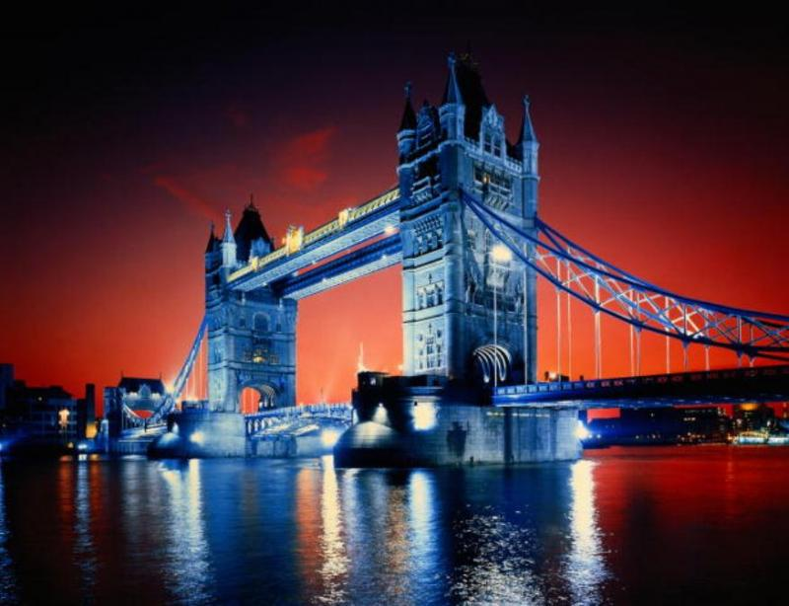
Great Britain

Slide 4
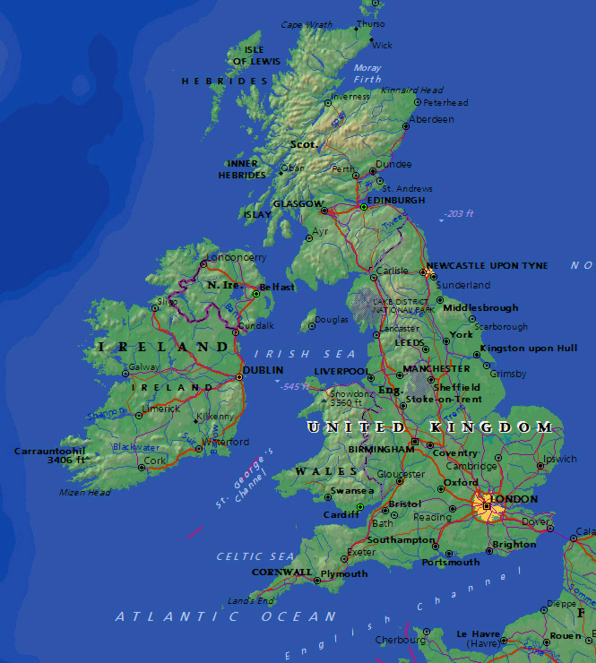
The United Kingdom of Great Britain and Northern Irelands is situated on the British Isles.
The British Isles consists of two large islands, Great Britain and Ireland, and about five thousand small islands.
Their total area is over 244,000 square kilometers.

Slide 5
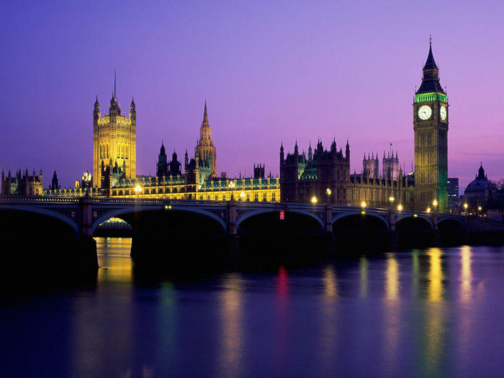
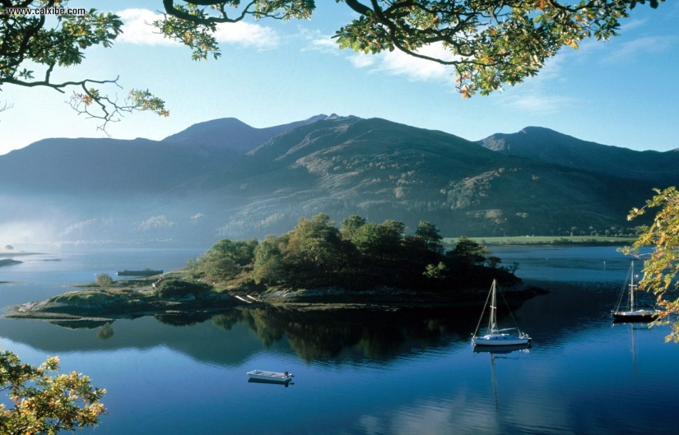
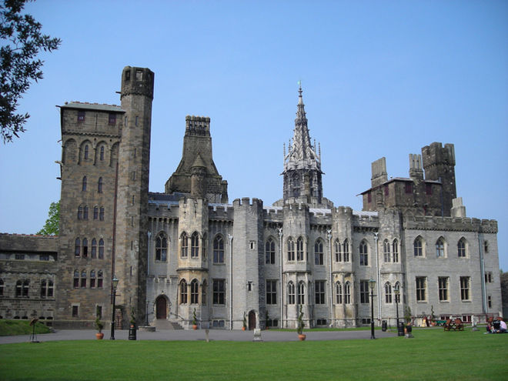
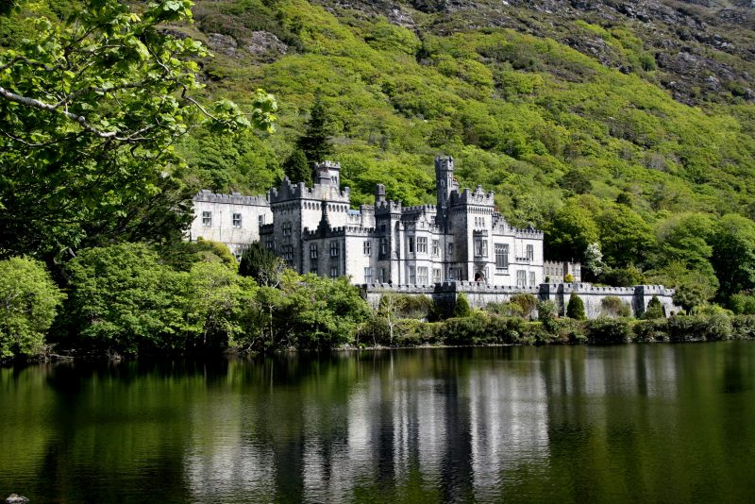
The UK is made up of four countries: England, Wales, Scotland and Northern Ireland. Great Britain consists of England, Scotland and Wales and doesn't include Northern Ireland.

Slide 6
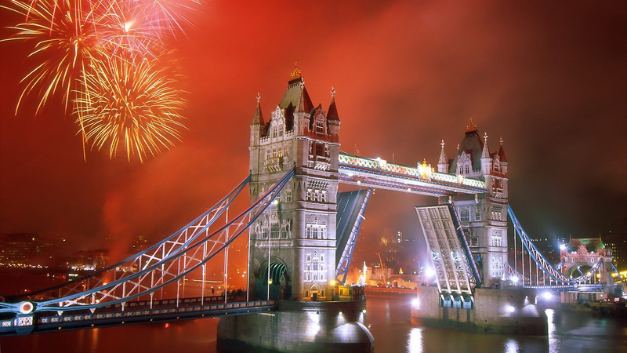
The capital of the UK is London.

Slide 7
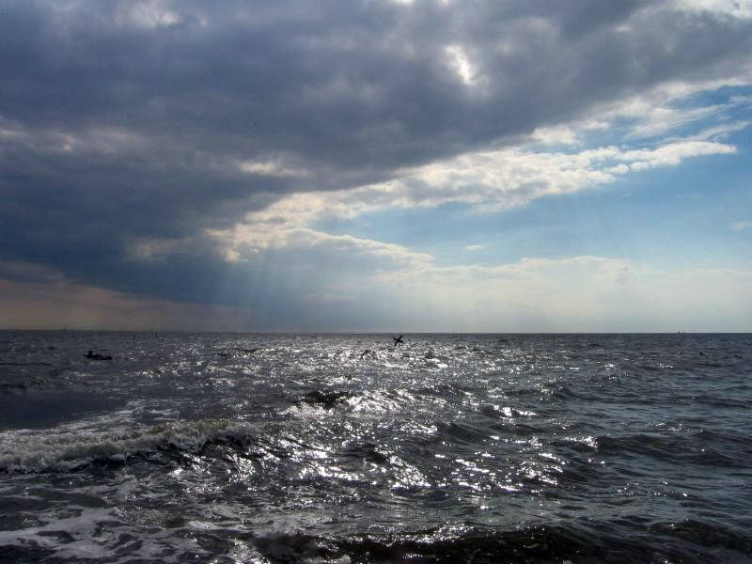
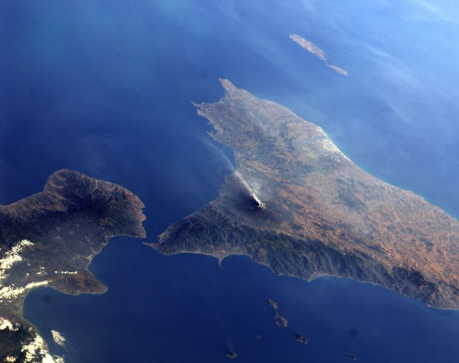
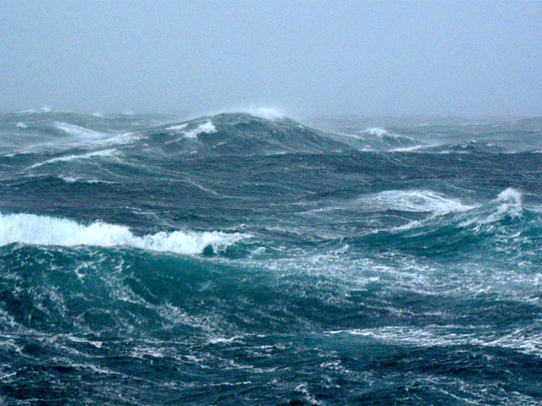
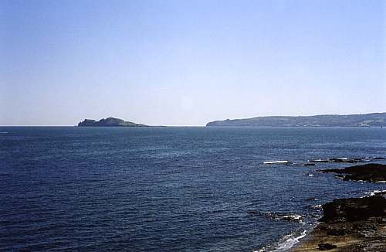
The British Isles are separated from European continent by the North Sea and the English Channel. The western coast of Great Britain is washed by the Atlantic Ocean and the Irish Sea.

Slide 8
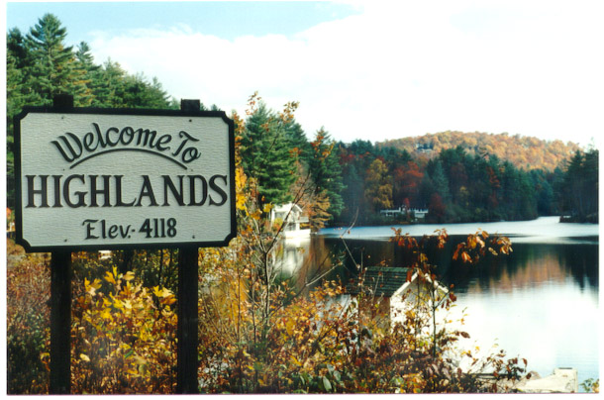
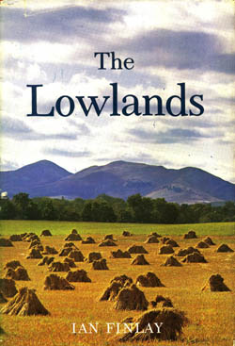
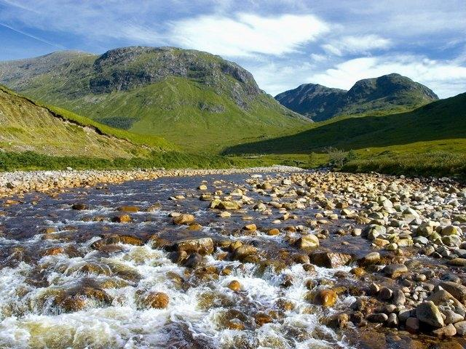
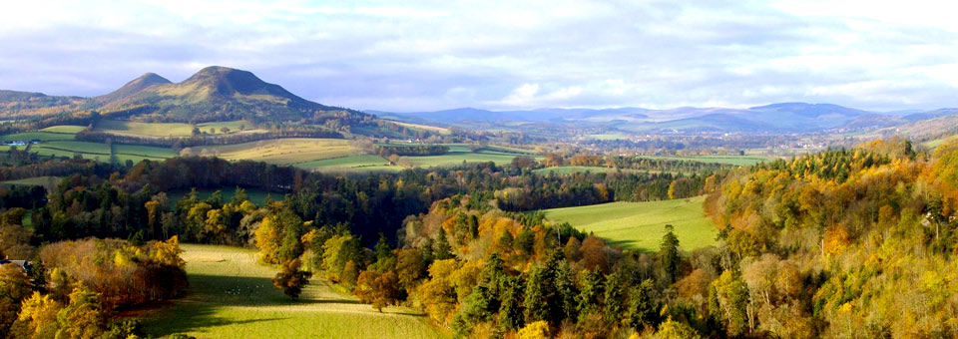
The surface of the British Isles varies very much. The north of Scotland is mountainous and is called the Highlands, while the south, which has beautiful valleys and plains, is called the Lowlands.

Slide 9
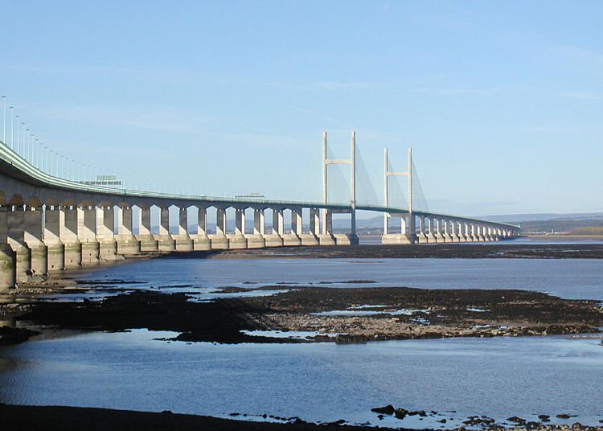
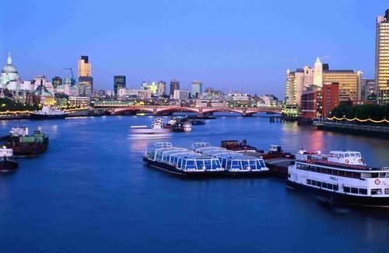
There are a lot of rivers in Great Britain, but they are not very long.
The Severn is the longest river,
while the Thames is the deepest and the most important one.

Slide 10
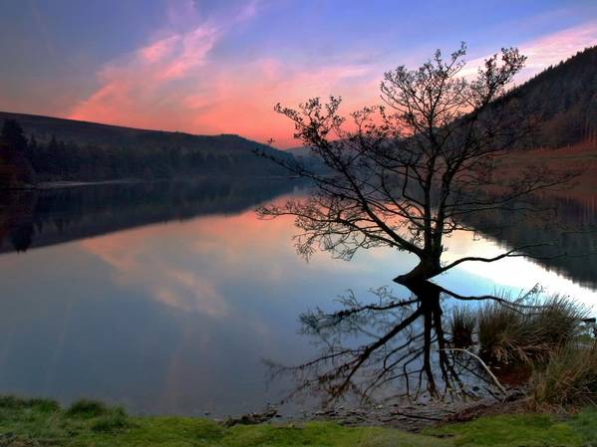
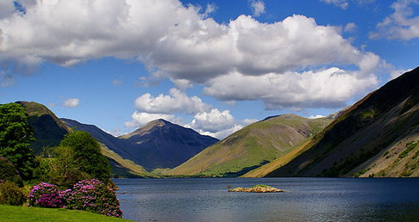
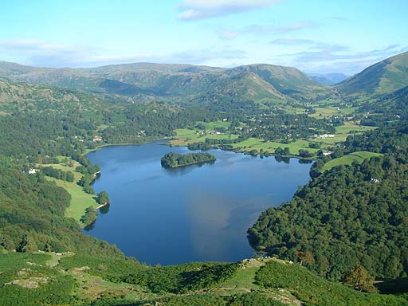
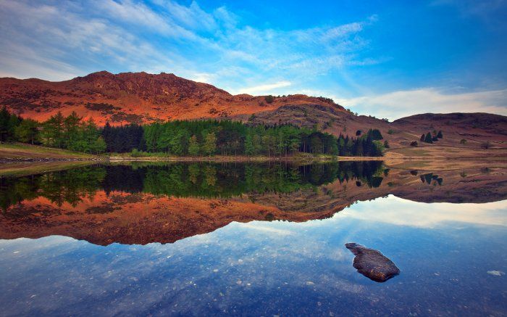
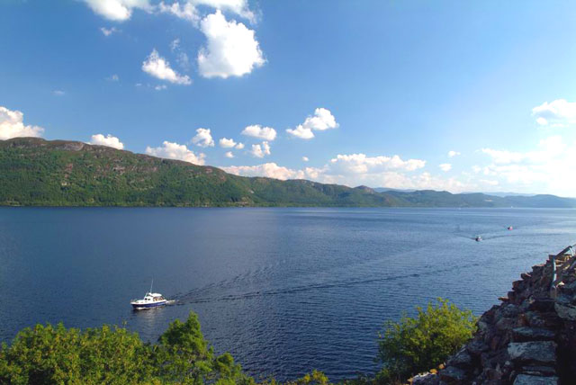
There are many lakes in Great Britain .

Slide 11
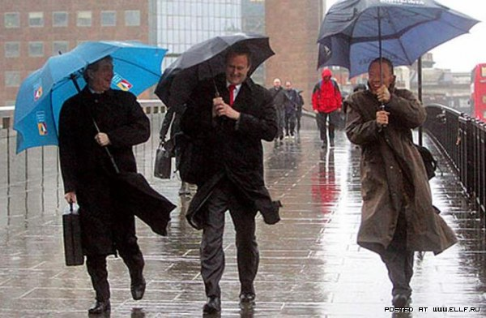
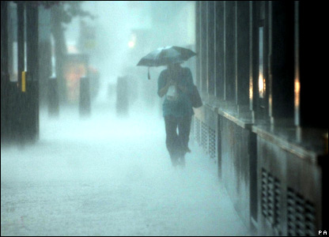
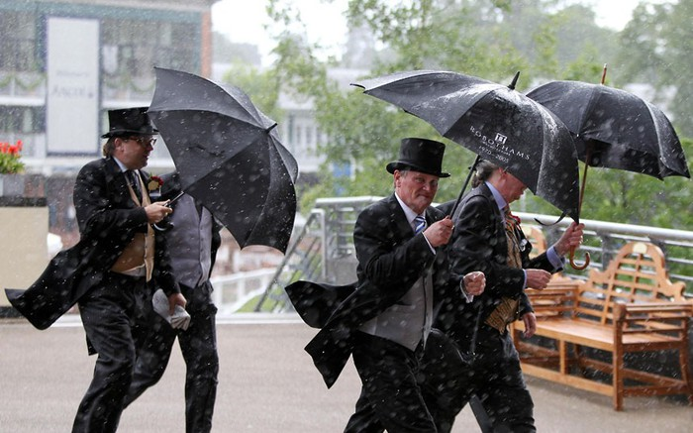
The weather in Great Britain is very changeable.
The English also say that they have three variants of weather:
when it rains in the morning, when it rains in the afternoon
or when it rains all day long.

Slide 12
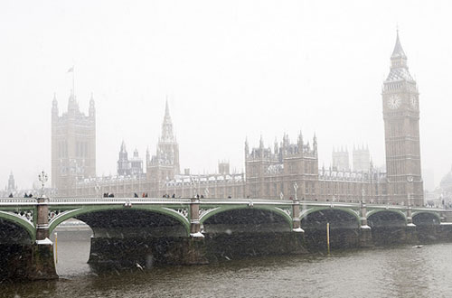
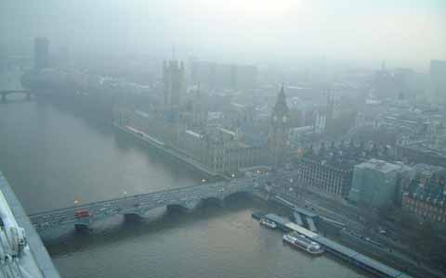
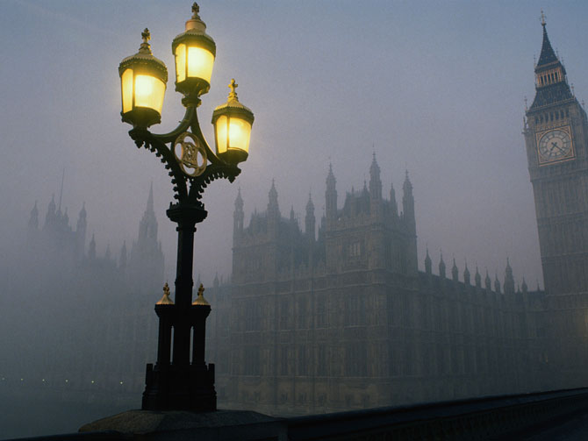
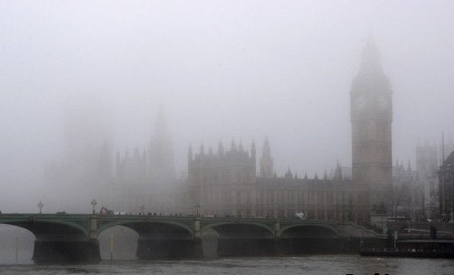
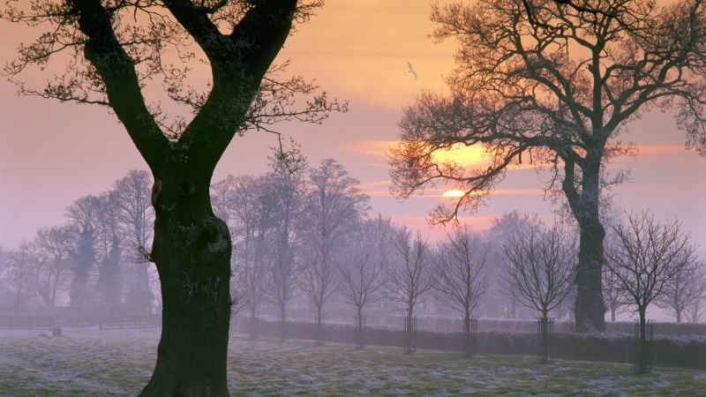
The most unpleasant aspect of English weather is fog and smog.

Slide 13
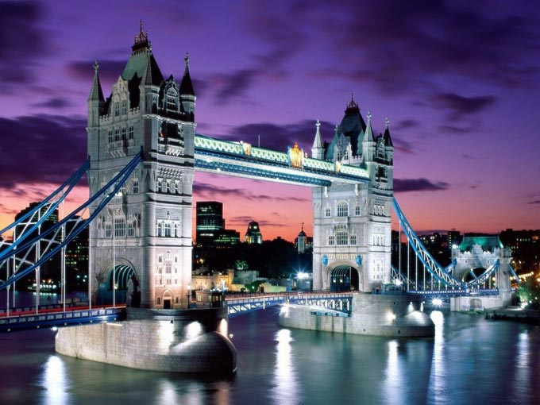
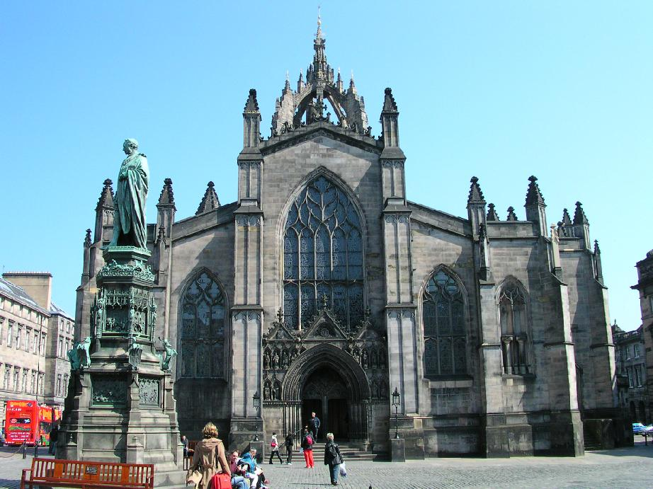
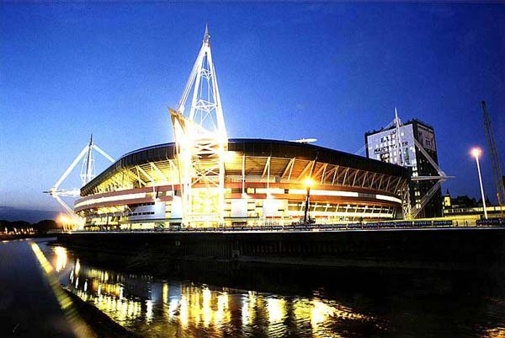
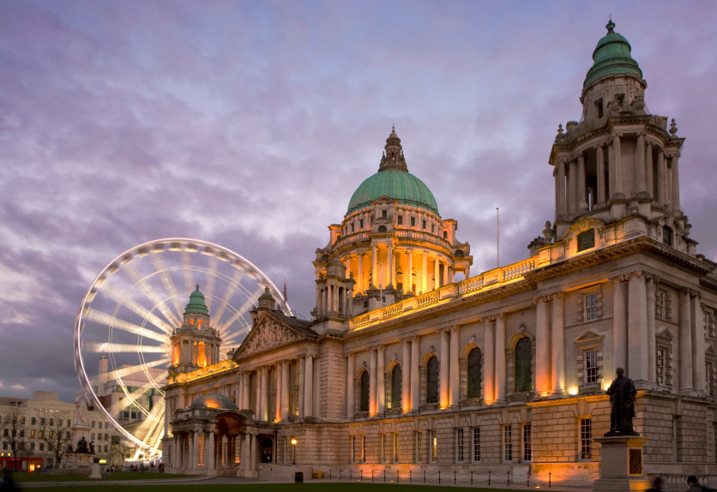
The capitals are: London in England , Edinburgh in Scotland , Cardiff in Wales and Belfast in Northern Ireland .

Slide 14
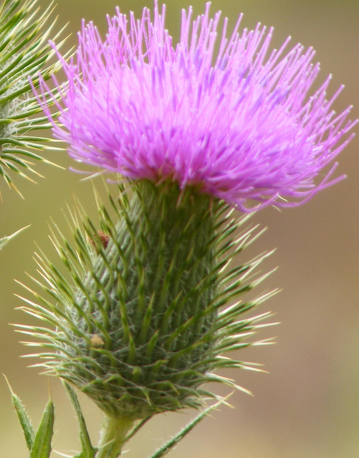
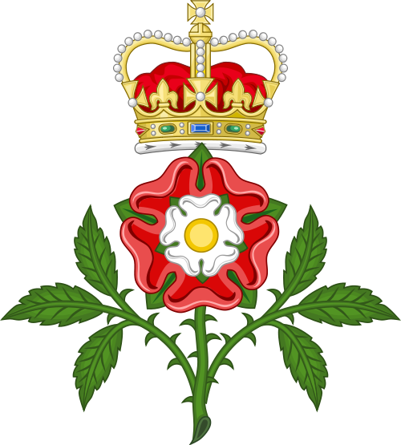
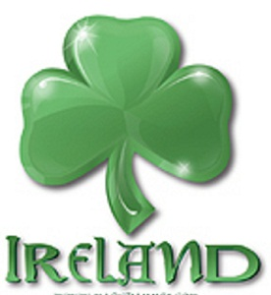
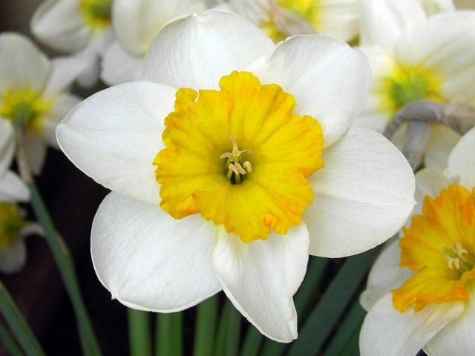
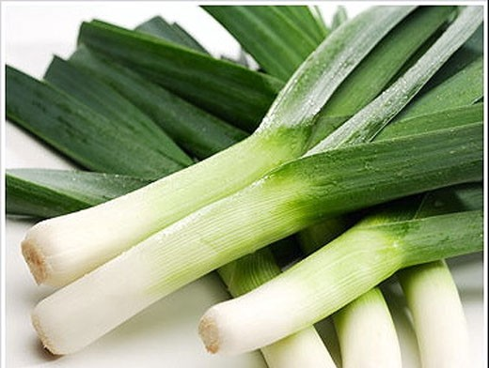
Every country has its own national emblem. The red rose is the national emblem of England. The thistle is the national emblem of Scotland. The daffodils and the leek are the emblems of Wales. The shamrock (a kind of clover) is the emblem of Ireland.

Slide 15
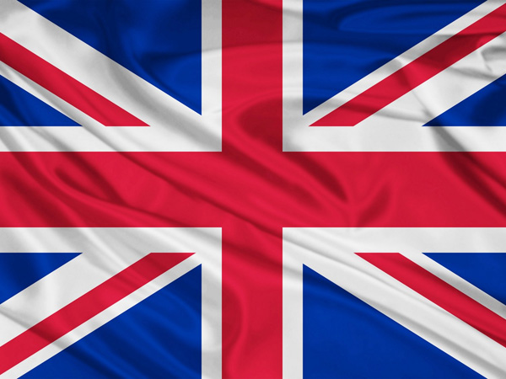
The flag of the UK is known as the Union Jack.The flag is made up of 3 crosses.
The upright cross is the Cross of St.George the patron saint of England . The white diagonal cross is the cross of St.Andrew, the patron saint of Scotland . The red diagonal cross is the cross is the cross of St.Patrick, the patron saint of Ireland . All of them are on the blue background.

Slide 16
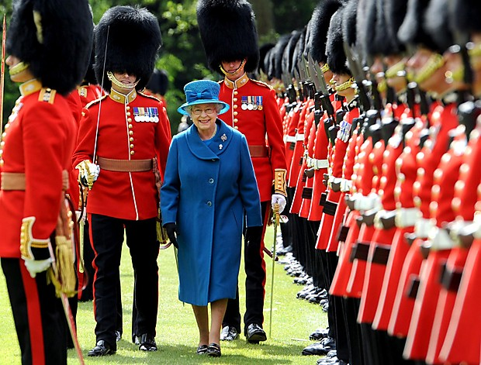
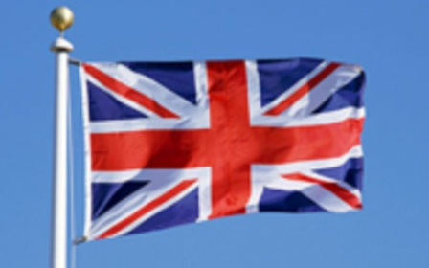
The national anthem is «God Save the Queen»
God save our gracious Queen, Long live our noble Queen, God save the Queen! Send her victorious, Happy and Glorious, Long to reign over us; God save the Queen!
O Lord our God arise, Scatter her enemies And make them fall; Confound their politics, Frustrate their knavish tricks, On Thee our hopes we fix, Oh, save us all!
Thy choicest gifts in store On her be pleased to pour; Long may she reign; May she defend our laws, And ever give us cause To sing with heart and voice, God save the Queen!
Not in this land alone, But be God's mercies known, From shore to shore! Lord make the nations see, That men should brothers be, And form one family, The wide world over
From every latent foe, From the assassins blow, God save the Queen! O'er her thine arm extend, For Britain's sake defend, Our mother, prince, and friend, God save the Queen!

Slide 17
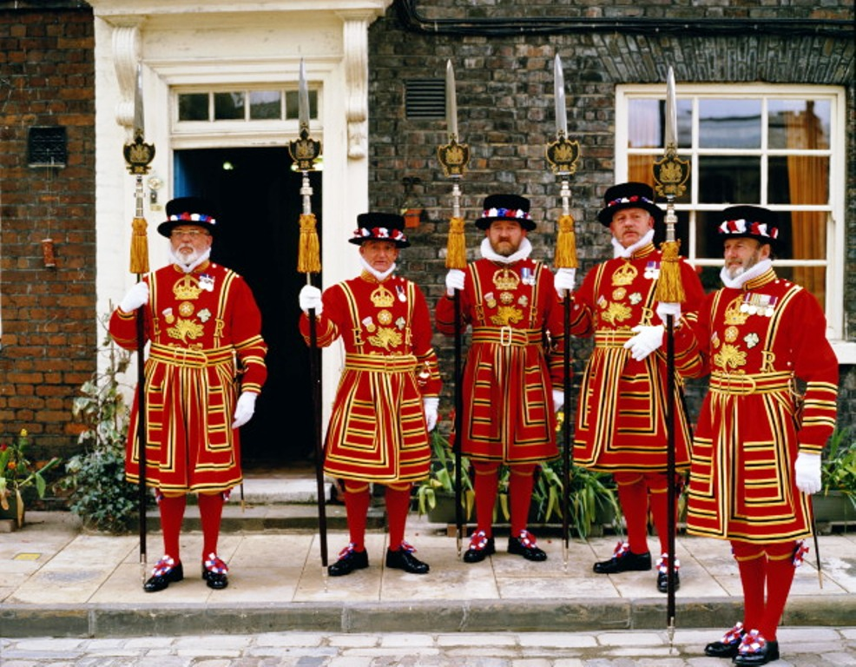
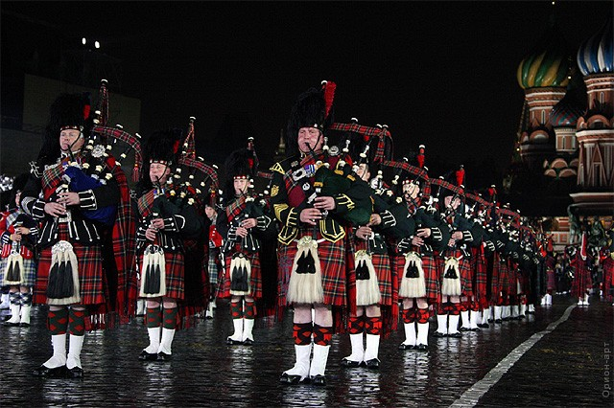
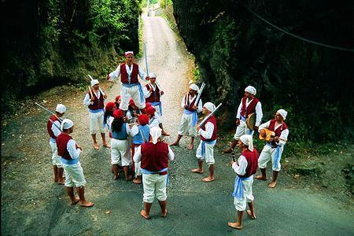
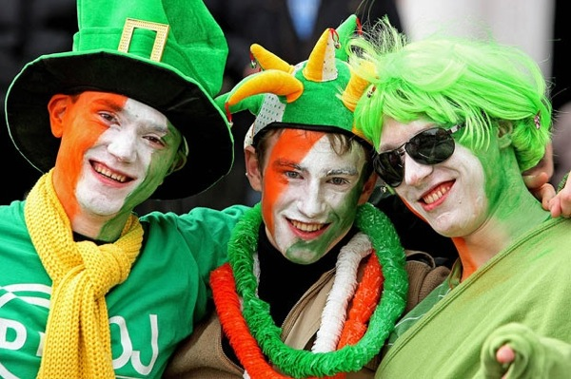
The population of the UK is over 58 mln people. The UK is inhabited by the English, the Scots, the Welsh and the Irish who constitute the British nation.

Slide 18
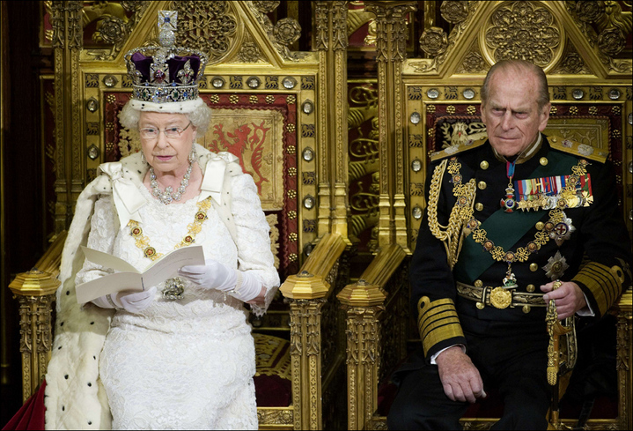
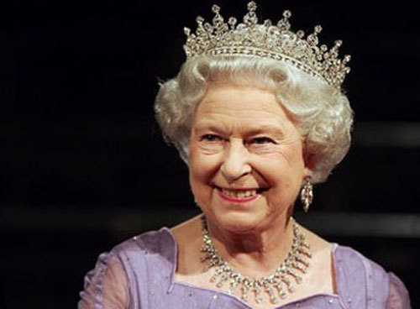
The UK is constitutional monarchy. In law, the Head of State is the Queen, but in practice, the Queen reigns, but does not rule. The country is ruled by the elected government with the Prime Minister at the head. The British Parliament consists of two chambers: the House of Lords and the House of Commons.

