Slide 1
Theme: Who is the best? Grade: 5 Executed by:Zholzhanova A. Ermakhanova A. Type of the lesson: Competition

Slide 2
The aims: Ағылшын тілінде,алған білімдерін, дағдыларын нақты ситуацияда қолдана білу; ой-өрісін кеңейту; логикалық ойлауды дамыту; тілдік, зияткерлік, танымдық қабілеттерін дамыту; -Топта жұмыс істеуді білу; ағылшын тіліне қызығушылығын арттыру; қарым-қатынас мәдениетін қалыптастыру.
The kind: a competition lesson
Visual aids: interactive board

Slide 3
Organizational moment:
Greeting
Divide into 2 teams

Slide 4
Our game consists of 7 rounds: Who is the fastest? Who knows more words? Polyglot Game Describing people. Do you know... Who are they?

Slide 5
Tongue twister
A tidy tiger tied a tighter tie to tidy her tiny tail

Slide 6
“Introducing” 1 st Team 2 nd Team Intelligents Clevers

Slide 7
First round: “Who is the fastest?”
1.How many seasons in a year?
2.What colors are on Kazakhstan Flag?
3. How many months in a year?
4.
How many days in a week?
5. How many letters are there
in English alphabet?
6.What color are the leaves in autumn?

Slide 8
Second round:”Who know more words?”
Bedroom
Living room
Bathroom
Kitchen

Slide 9
Key:
Bedroom: bed, pillow
Poster,wardrobe,desk
Living room: sofa, carpet
curtains, armchair.
Bathroom: mirror, bath
Toilet, washbasin.
Kitchen: fridge, sink, cooker,
Table, chair.

Slide 10
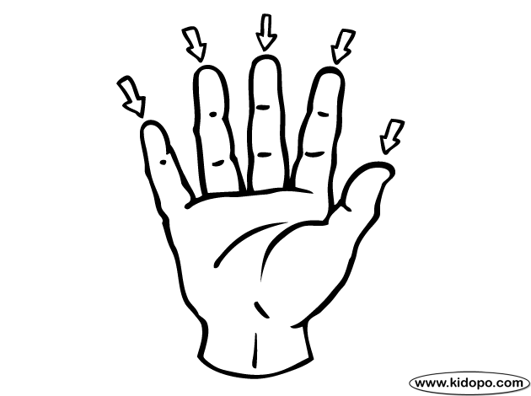
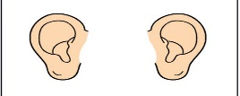
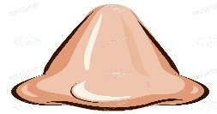
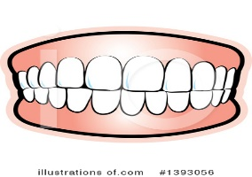
Third round: "Polyglot”
We can count with …
We can see with …
We can touch with …
We can run with …
We can hear with …
We can smell with ..
We can eat with …
We can bite with …
fingers
eyes
hand
legs
ears
nose
mouth
teeth

Slide 11
Fourth round: Game

Slide 12
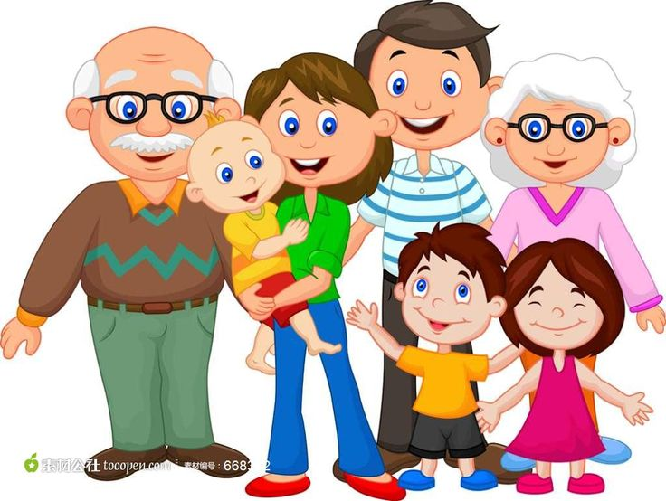
Fifth round: “Do you know?”
DGANDRA-?
NIUCOS-?
NAGMDRA-?
FWEI-?
RTORHEB-?
PWHENE-?
ADD- ?
EIECN-?
TUNA-?
SHNDBUA-?
UMM-?
EISSRT-?
GDAHURTE-?
CUENL-?
NSO-?

Slide 13
Sixth round “Describing people”

Slide 14
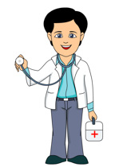
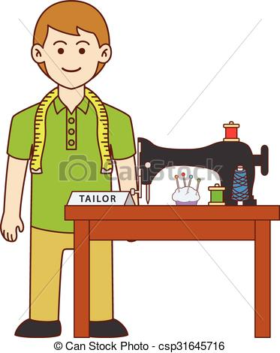
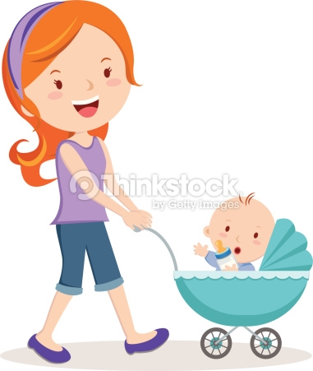
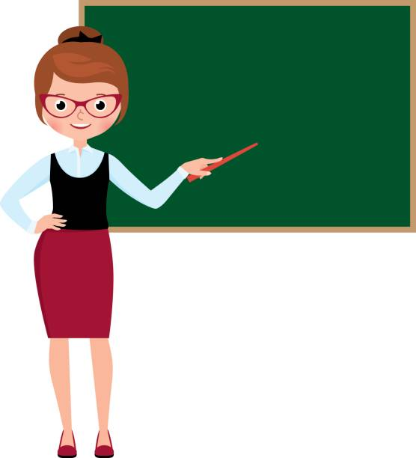
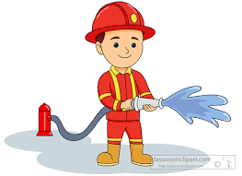
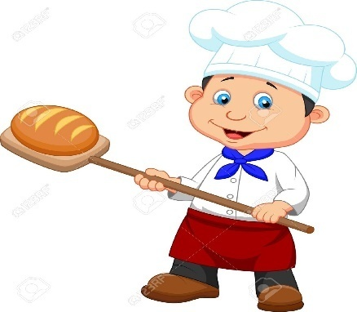
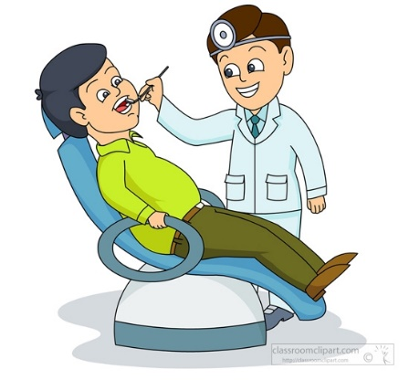
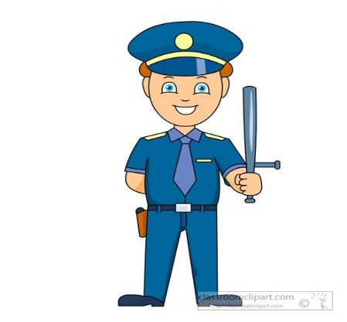
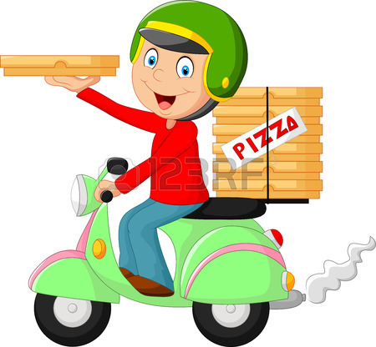
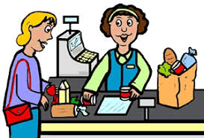
Seventh round “Who are they?”

Slide 15
The 4th letter of an English alphabet :

Slide 16
First day of the week?

Slide 17
What colour is the tree?

Slide 18
What antonym of the word serious?

Slide 19
Eating in the morning is called what?

Slide 20
The great Kazakh poet …..

Slide 21
Tell an English poem…

Slide 22
Thank you for attention!

