Slide 1
Language Focus Present Perfect: questions
Grade 6

Slide 2
Present Perfect
Video

Slide 3
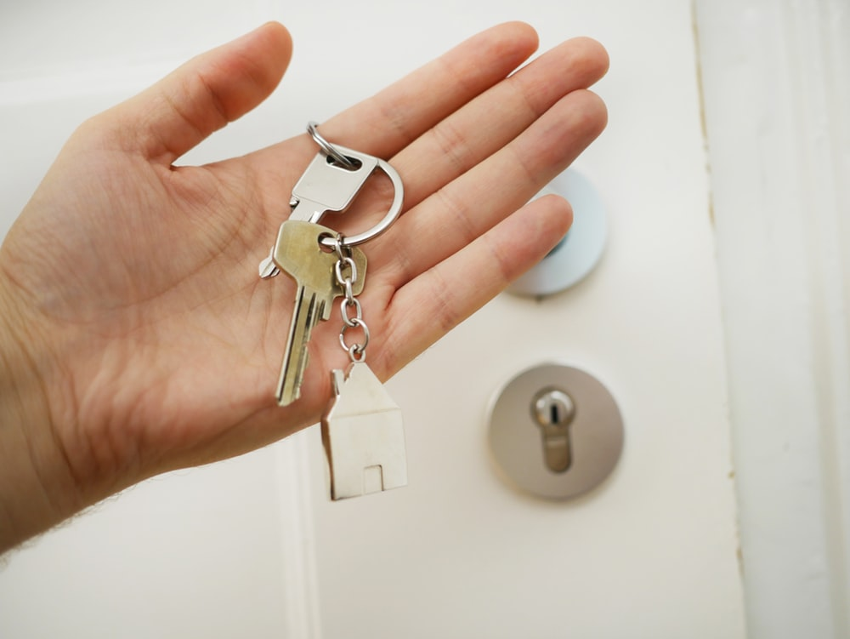
When we use:
Something happened in the past.
But it has connection with the present
I have lost my keys

Slide 4
Form
Have/has +V3

Slide 5
Past Participle or V3
Regular verbs | Irregular verbs
Verb + ED Play-played Stay-stayed Love-loved | Go - went –gone Do - did - done Lose – lost - lost Take – took - taken

Slide 6
Affirmative Хабарлы | Negative Болымсыз | Question Сұраулы
I have seen this movie She has cleaned the house They have eaten lunch | I have not seen this movie She has not cleaned the house They have not eaten lunch | Have you seen this movie? Has she cleaned the house? Have they eaten lunch?

Slide 7
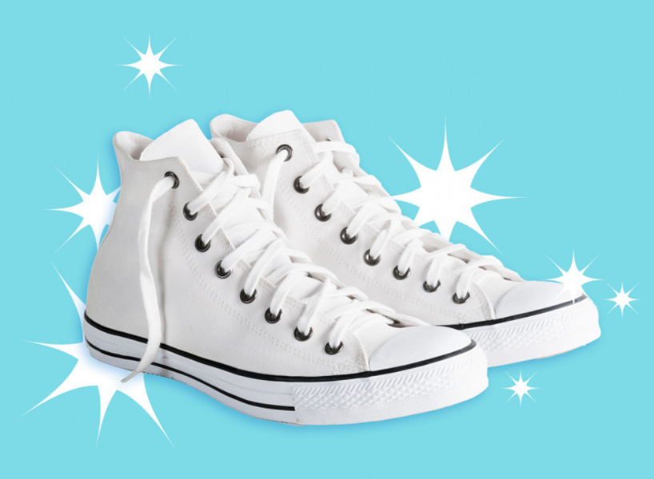
I have cleaned my shoes

Slide 8
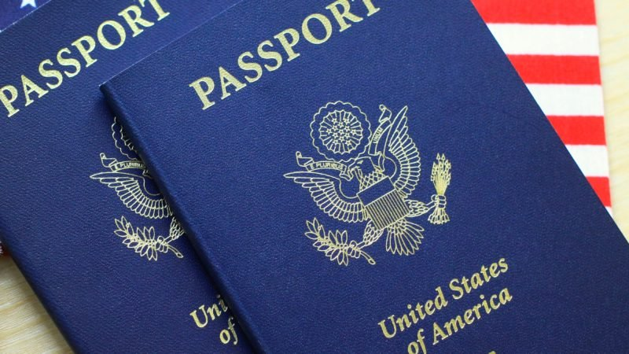
I have lost my passport

Slide 9
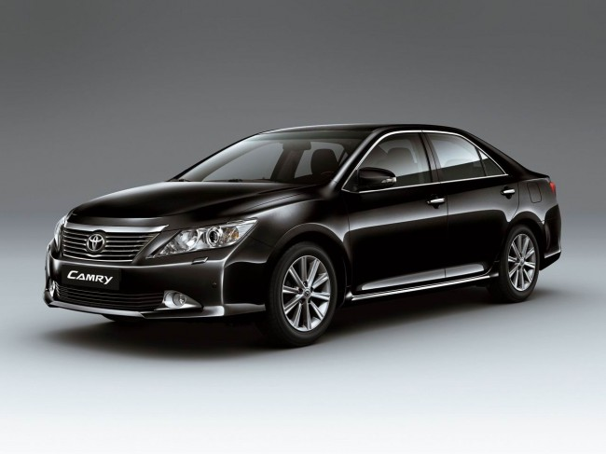
We have bought the new car

Slide 10
Somebody has broken the window

Slide 11
Have you cried during sad movie?
Have you ever been lost?
Have you tried Chinese food?
Have you had a toothache?
Have you ever been in TV?
Have you ridden a horse?
Have you swim the ocean?
Have you made a snowman>
Have you done something dangerous?
Have you met a famous person?
Have you ever slept for more than 12 hours?
Have you seen a ghost?

Slide 12
Homework
Exercise 2, 3. p59
Exercise 2, 7. p61

