Slide 1
«№23 орта мектеп »КММ Demonstrative lesson The theme: All about Rick Form: 4 «Б» Бақбергенова Самал Манасқызы

Slide 2
Warm-up
Match the sports with the pictures. Then listen and check
Swimming skateboarding football
horse riding skiing basketball
ice-skating cycling
Example: 1 - cycling

Slide 3
3. Checking – up of the home task What was your home task? Now let’s check up.

Slide 4
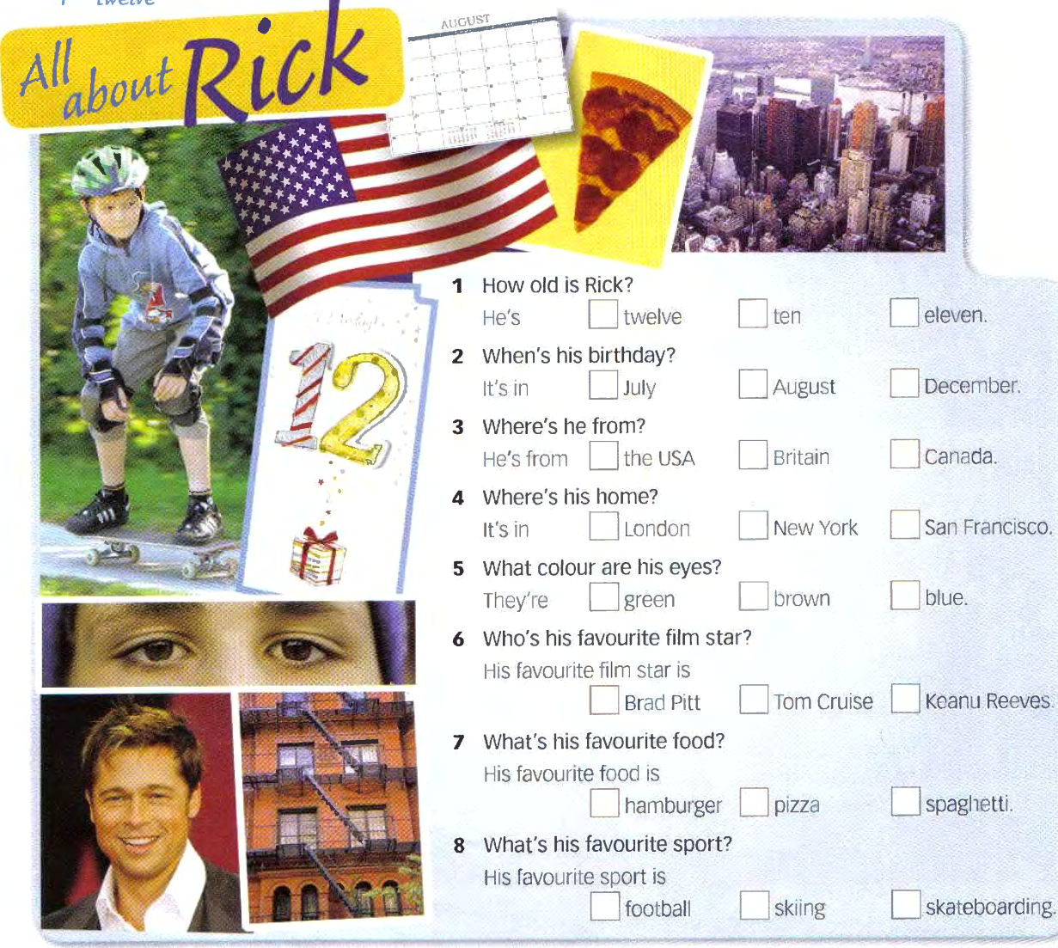
4. Presentation - Listen to the questions. Can you guess Rick’s answers? Write your ideas Children listen the audio from CD and answer for the questions.
- Now listen to Rick’s answers.

Slide 6
Special questions

Slide 7
Who? – кто? What?– что? When? – когда? Where? – где? How old?– сколько лет?

Slide 8
The word order in the sentence
1-Q 2-AV 3-S 4-MV …..
Q – question
AV – auxiliary verb
S – subject
MV – Main verb

Slide 9
Special questions are used to get detail information about somebody or something
Examples:
We will go to the cinema today.
- Who will go to the cinema today?
Кто сегодня пойдет в кино?
- When will we go to the cinema?
Когда мы пойдем в кино?
- Where will we go today?
Куда мы сегодня пойдем?

Slide 10
Practice 1.Grammar practice: 1. What is his favourite sport? A. It’s in New York 2. Who is your favourite film star? B. She is ten 3. When is her birthday? C. Football 4. How old is she? D. Keanu Reeves 5. Where is your home? E. It’s in May

Slide 11
2.Speaking. - Complete the questions with what, when, who, how, where ____ old are you? I’m … ____ is your birthday? It is in … ____ are you from? I am from… ____ is your home? It is in … ____ colour are your eyes? They are … ____ is your favourite film star? My favourite film star is … ____ is your favourite food? My favourite food is … ____ is your favourite sport? My favourite sport is … Write notes about your classmates

Slide 12
Production
Fill the card «All about You»
Write 7 sentences about your classmates
Make up a dialogue on the theme «All about You»

Slide 13
Home task and Evaluation
Your home task will be Exercise 9, page 19

Slide 14
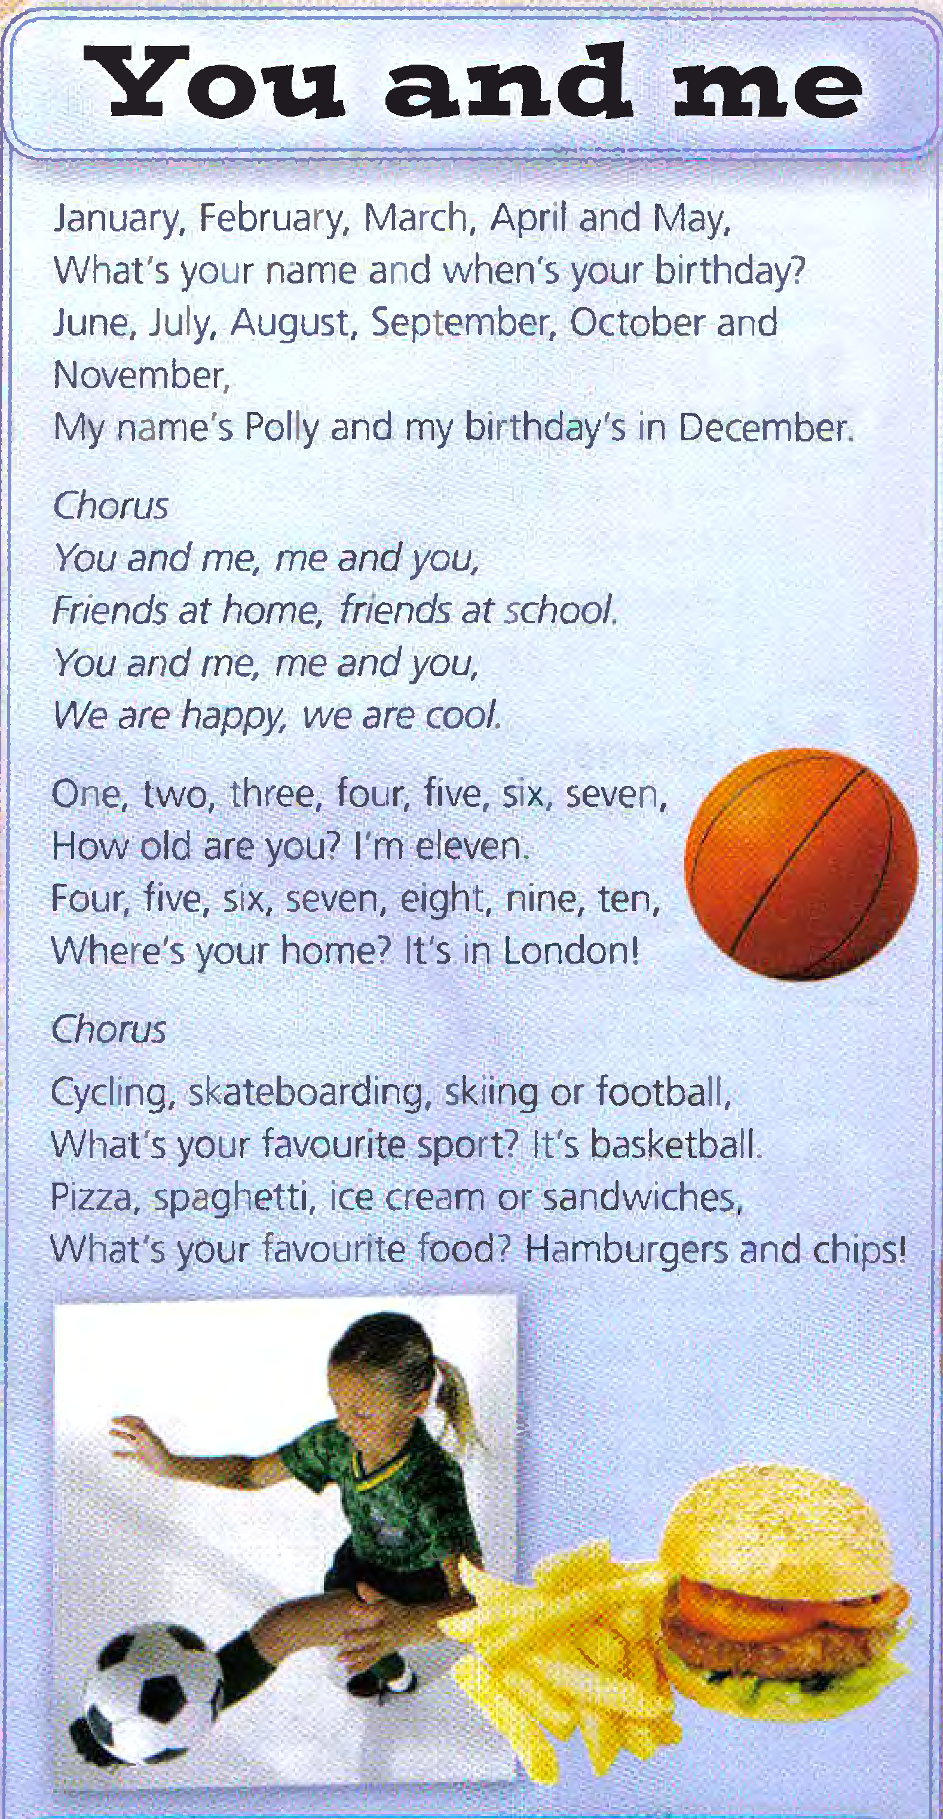
Relaxation. Conclusion
Let’s sing a song
«You and Me»

