Slide 1
The 22nd of November
Ecological problems

Slide 2
For dividing into two groups, please, change stickers.
Second group
First
group

Slide 3
Answer the questions
1) Is there anything you would like to change about your city?
2) What can you do to make your city change?

Slide 6
What are you think about this video?

Slide 7
Mingling activity
Items for first group
Categories for second group

Slide 8
Socratic talk
Pupils have only 1 minute for reading text in cards
In circle – first group
Out of circle – second group

Slide 9
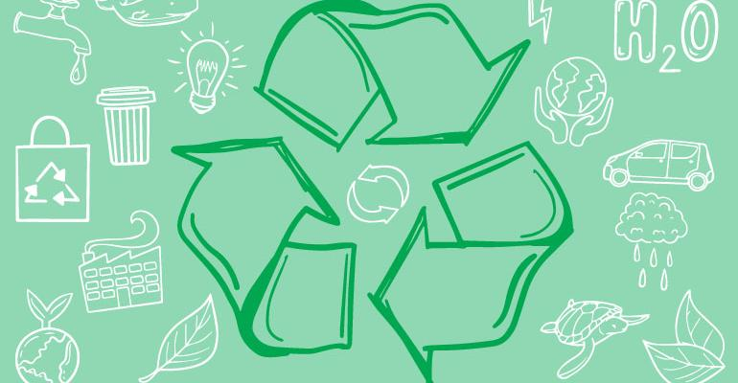
Craftwork. Pupil’s works

Slide 10
Pupil’s opinion about air and water pollution
First group – water pollution
Second group – air pollution

Slide 11
Project work. Problem-solving discussion.

Slide 12
Giving home task
WB p.28

Slide 13
Pupil’s assessments for each other

