Slide 1
Educational programme for the in-service training of the English Language pedagogical staff in the context of the updated curriculum for comprehensive school education in the Republic of Kazakhstan
GRADE: 1
Theme of the lesson: Food and drink
Kazakh secondary school of Kyrgauldy
Suleymenova Alina Erkinovana

Slide 2
Learning objectives(s) that this lesson is contributing to
1.UE9 use basic present simple forms [positive and negative] to give basic personal information
1.S3 pronounce basic words and expressions intelligibly
1.S5 produce words in response to basic prompts
1.S1make basic personal statements and simple statements about objects

Slide 3
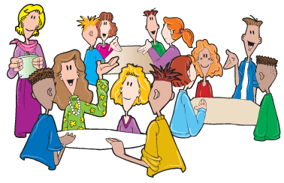
Lesson objectives
,
listen and repeat the words,
follow the instruction according
to the task
All learners will be able to:
Make more than 2 sentences correctly using different sentence structure
Most learners will be able to:
Make more than 4 sentences and
read some of the words from the topic
Some learners will be able to:

Slide 4
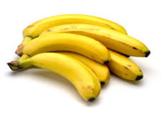
Language objectives
Use basic personal and demonstrative pronouns and quantitative pronouns;
Leaners can:
Key words and phrases:
Food and drink items
I like milk. I don’t like milk.
ORAL
Useful classroom language for dialogue/writing:
Can you say why an ice cream yammy?
Discussion points
what is it? Do you like milk?
Writing prompts:
no used.

Slide 5
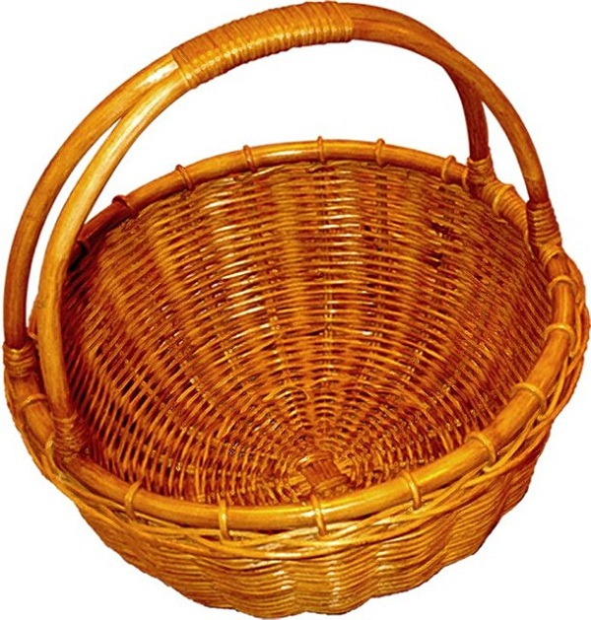
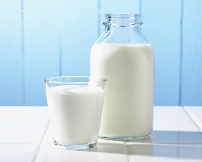
Beginning 5min
Warm up activity. T should divide Ls into 3 groups using there puzzles juice, bananas, cheese.
T gives to each group half of the cards of the food and make them find the other half and guess what the pictures are. T will encourage Ls to name them in Kazakh /Russian language
(milk, ice cream, cheese, bananas, apple, eggs, chicken, tomatoes.)
Tell the learners about what they are going to do today:
So let’s count how many words do we have in a basket?
One, two, three …. eight, and today we will learn 8 new words.

Slide 6
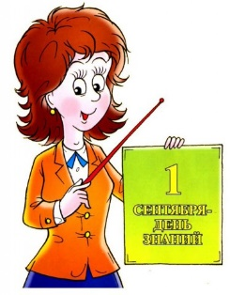
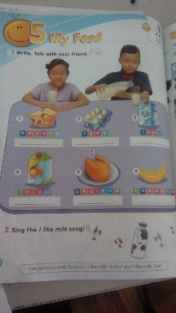
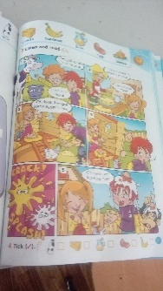
Middle 30min
pp.60 -61 Activity TPR shows picture and repeat.
Teacher drills pronunciation of the words correctly.
Once they repeat after the T, then they repeat individually. Whole class
p.60 ex.2 Activity sing a song. Do you like …?
Listen to the song and repeat the gestures teacher shows. Then sing and dance the song together.
Whole class.
Activity. Group work. Drill the sentences prompts I like \ I don’t like. SS-SS
Go back to the PPT and make up sentences together with students.
Do you like….? Yes, I do. It’s yummy
Do you like ….? No, I don’t. It is yucky!

Slide 7
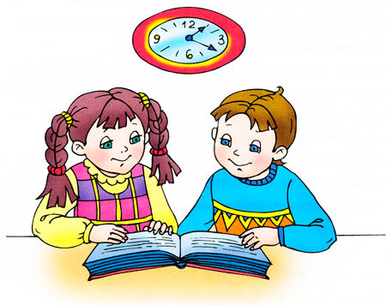
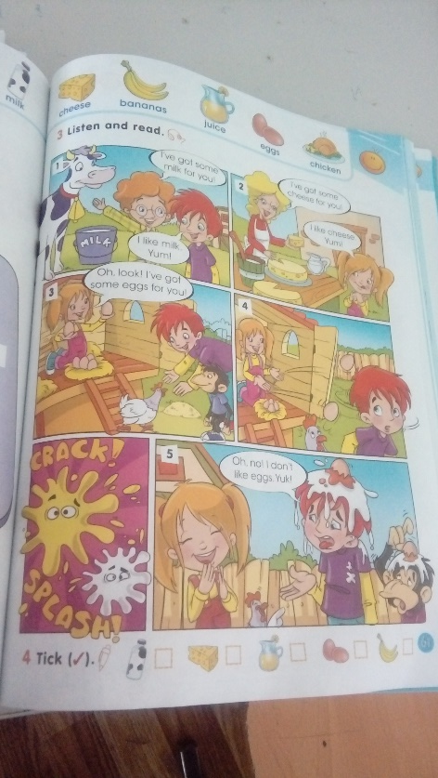
Middle 30min
P.61 Pair work. T will invite one L and model to the class the next activity. S-S
Ls have cards with new words.
They should ask their partner using these cards.
Do you like….? Yes, I do. It’s yummy
Do you like ….? No, I don’t. It is yucky!
T will go around the class and listen their conversation.
P.61 ex4. Activity. Individual work.
Ls listen the text and tick key words.

Slide 8
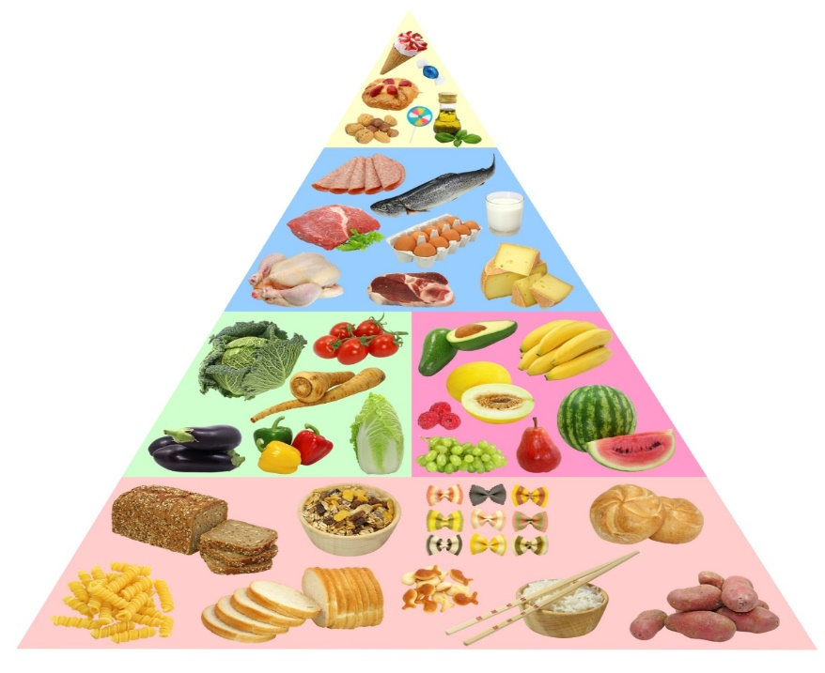
End 10min
Feedback
T asks learners a word in their native language, Ls have to show it.

Slide 9
End 10min
Activity. Individual work
DRAW THREE BROWN EGGS
DRAW TWO RED TOMATOES
DRAW YELLOW CHEESE
DRAW THREE BROWN EGGS
DRAW TWO RED TOMATOES
DRAW YELLOW CHEESE
Assessment criteria | Task | Descriptor | Mark
He /she should know key words and count number. He/she should show colours. | Task 1 Task2 | To say key words To count numbers To know colours | 3 3 3
Total mark |  |  | 9

