Slide 1
Seasons &
Weather

Slide 2
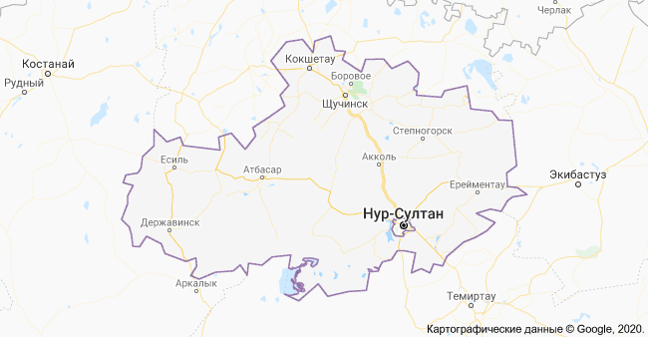
Kokshetau

Slide 3
Learning objectives(s)
2.S3 pronounce familiar words and expressions intelligibly;
2.R3 recognise and identify some familiar sight words from local environment

Slide 4
Lesson objectives
All learners will be able to:
-name the main vocabulary words;
-write weather vocabulary words;
-use them in their speech.
-name four seasons
-describe the pictures

Slide 5
When the weather is wet,
We must not fret.
When the weather is dry,
We must not cry.

Slide 6
When the weather is warm,
We must not storm.
When the weather is cold,
We must not scold.

Slide 7
Be thankful together,
Whatever the weather.

Slide 8
Vocabulary
experience – испытывать harvest - урожай
covered - покрытый foliage - листва
bare - голый awesome - потрясающий
occasionally - иногда rhyme – стишок
awaken – просыпаться, пробуждать fret - волноваться
meadow - луг scold – ругать
overcast - пасмурный whatever – что / какой бы ни
lightning strike – удар молнии

Slide 9
4 seasons
winter
spring
summer
autumn

Slide 10
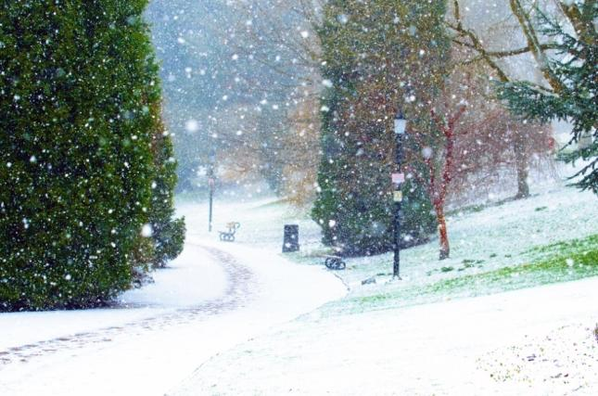
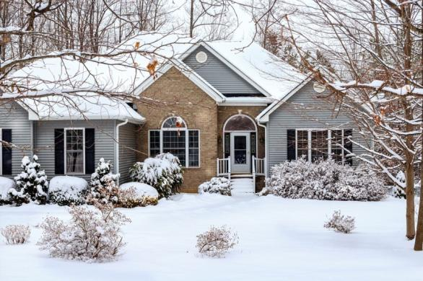
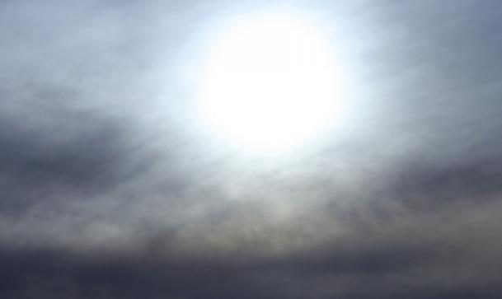
Winter

Slide 11
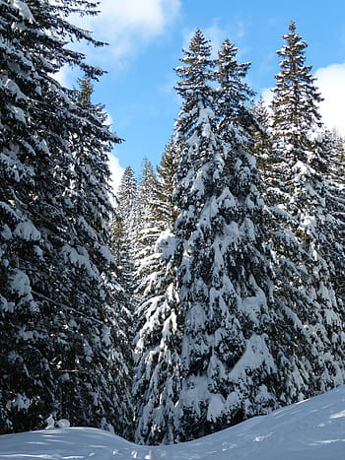
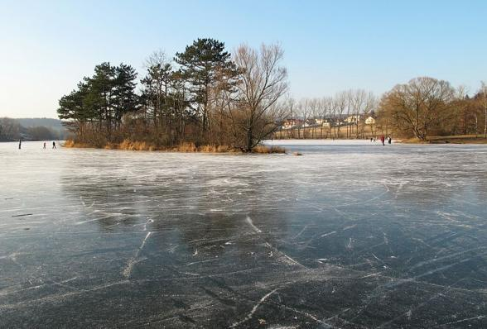
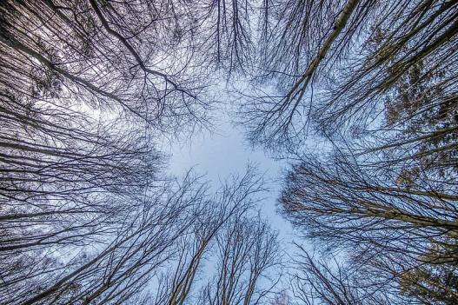
Winter
-20°

Slide 12
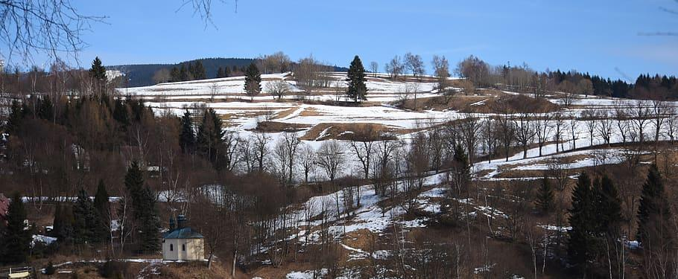
Spring
March
April
May

Slide 13
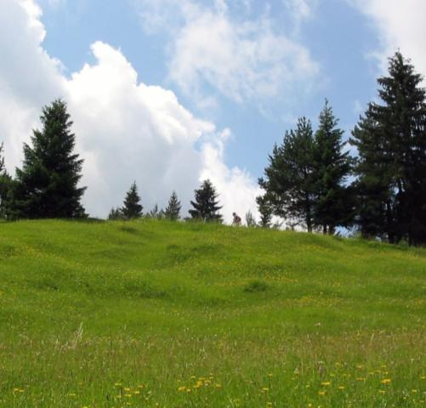
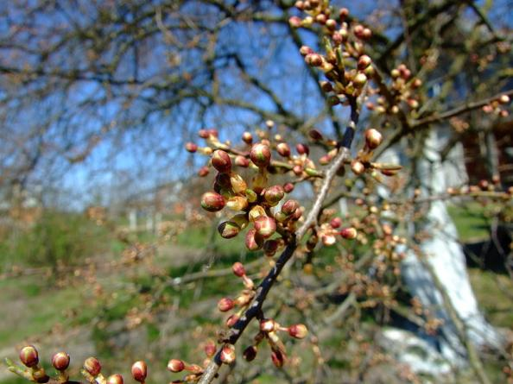
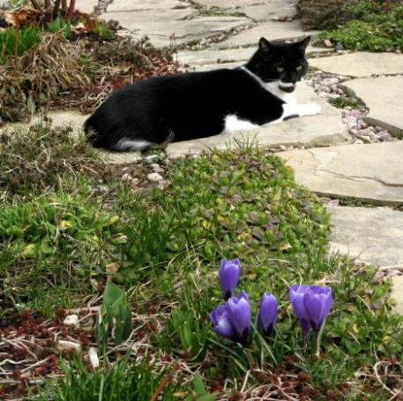
Spring

Slide 14
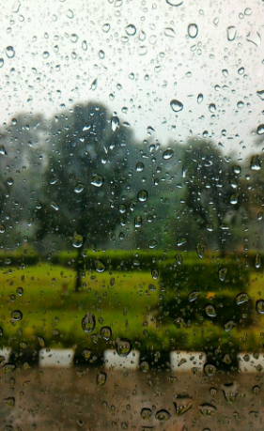
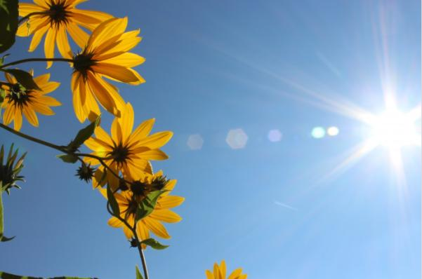
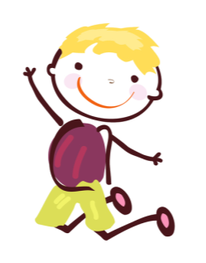
Spring

Slide 15
Summer
days
nights
June
July
August

Slide 16
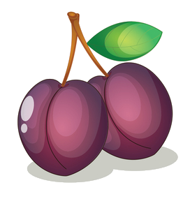
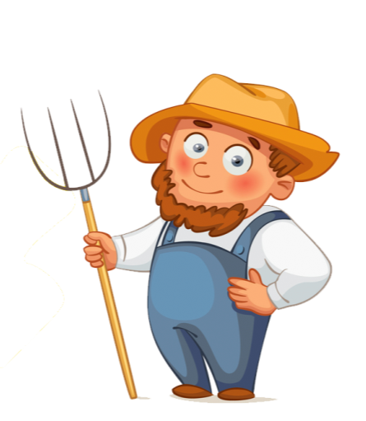
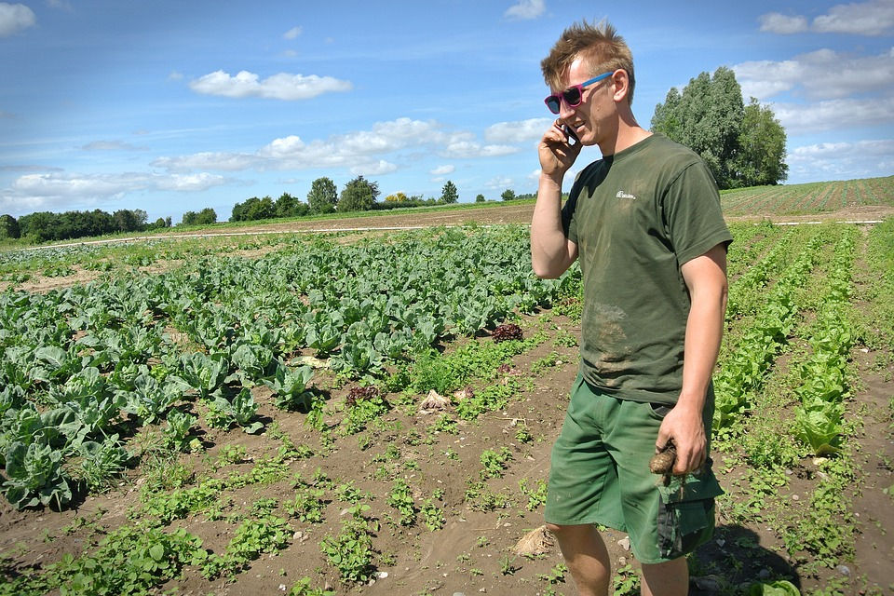
Summer

Slide 17
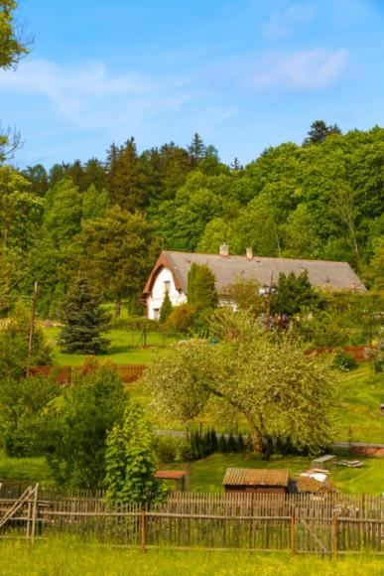
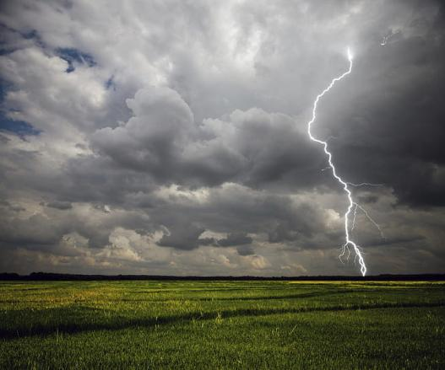
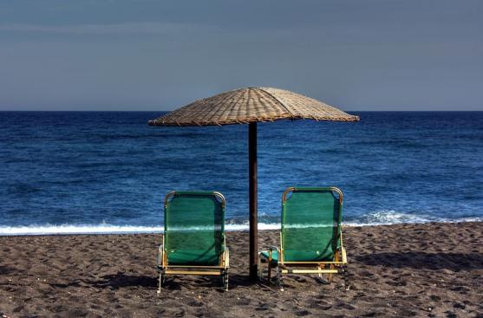
Summer

Slide 18
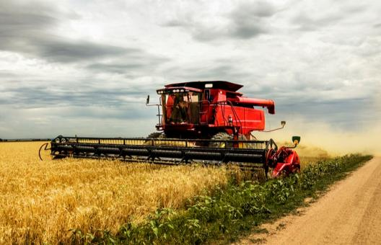
Autumn
days
nights
harvest time

Slide 19
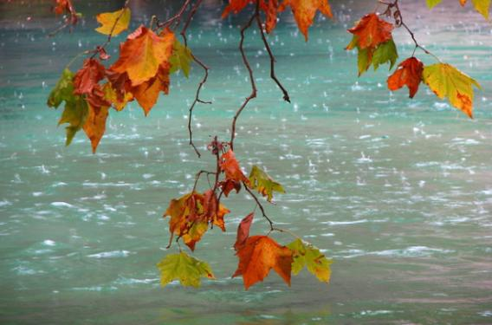
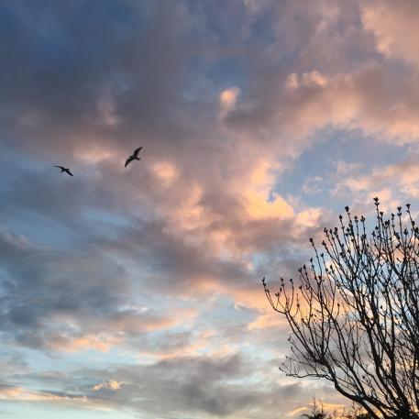
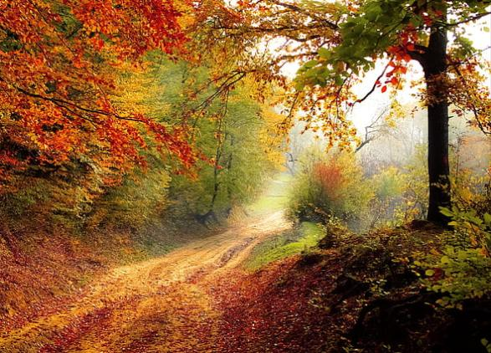
Autumn

Slide 20
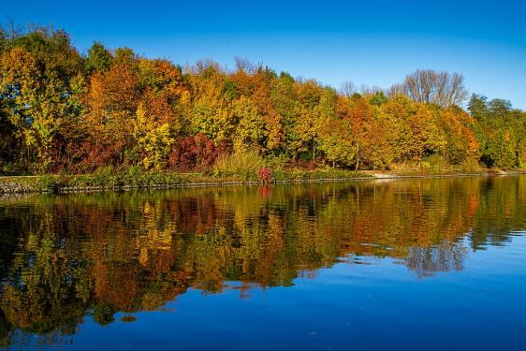
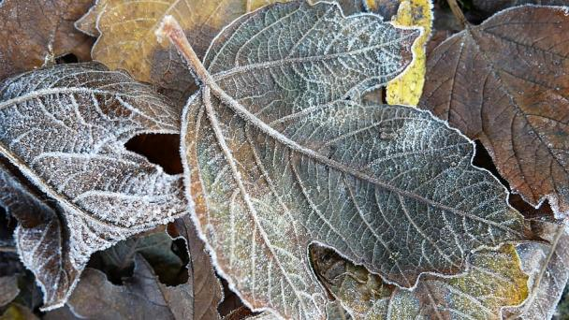
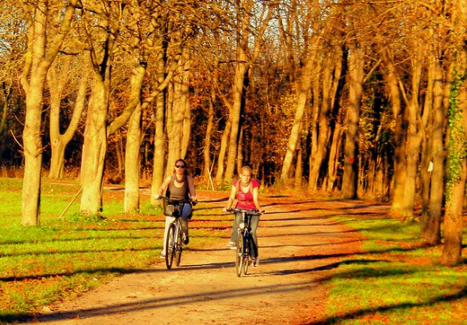
Autumn

Slide 21
4 seasons
the weather continuously
changes;
you can never get bored;
each season has its own
bright sides.

Slide 22
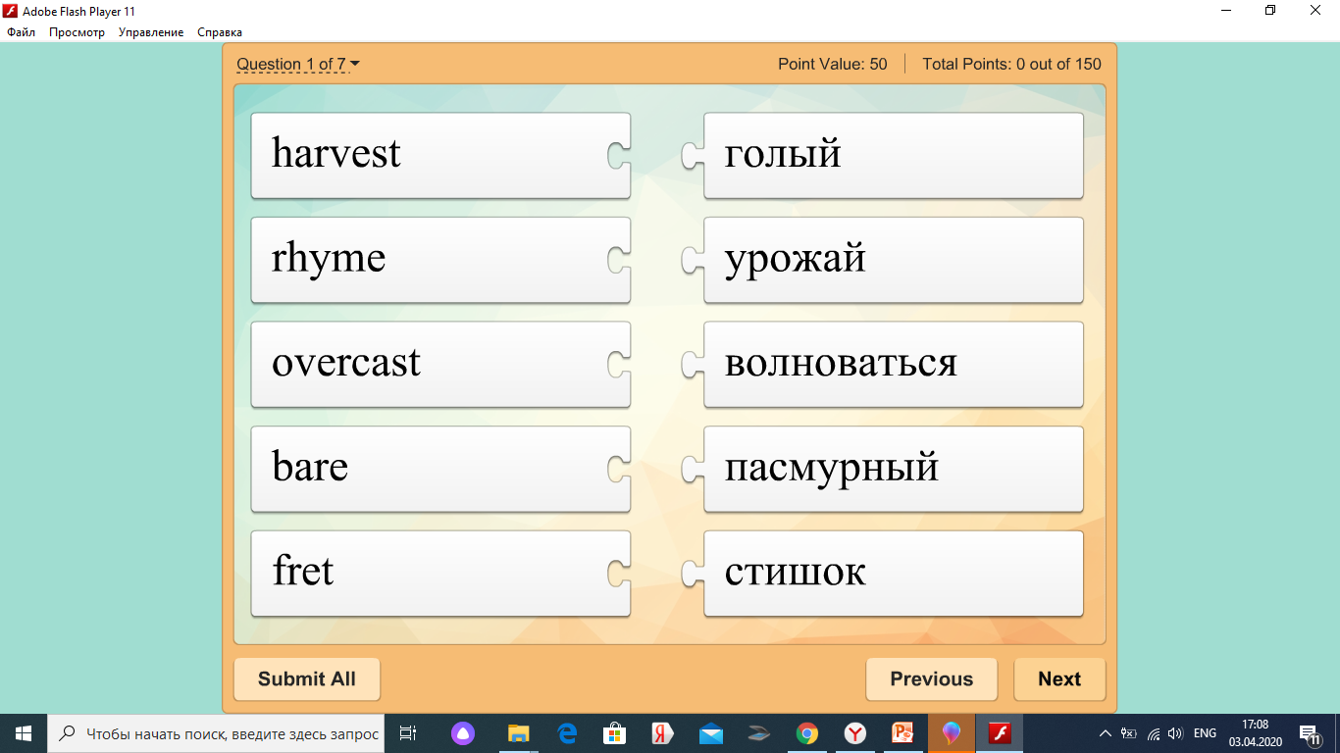

Slide 24
Answer the quesrion
1. What season is after spring?
2. What season is before winter?
3. What season is between autumn and spring?
4. What season is after winter?
5. What month is before January?
6. What month is after February?
7. What month is between April and June?
8. What month is between September and November?

