Slide 1
Grade 1
The theme: Hot or cold:
Yes, he does /
No, he doesn’t
Nagashybaeva A.U

Slide 3
GRAMMAR STRUCTURE
Yes, he does /
No, he doesn’t /
Language focus
I am hungry
I am thirsty

Slide 4
Do
You
We
they
like+ food?
Yes, I do+
No, I don’t-
You- сен
They-олар
We-біз

Slide 5
+Yes, he does -No, he doesn’t
Does
He
She
It
Like + food?
He-ол- ер баланы айтамыз
She-ол-қыз баланы айтамыз
It-бұл- жануарларға, заттарға айтамыз
Your -Сенің

Slide 6
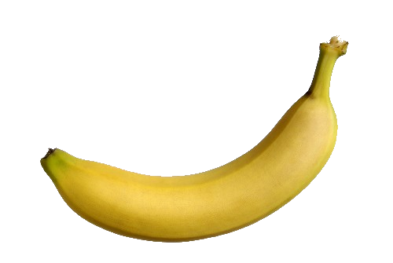
Does she like?
Banana

Slide 7
Banana
Yes, she does. It’s Yummy

Slide 8
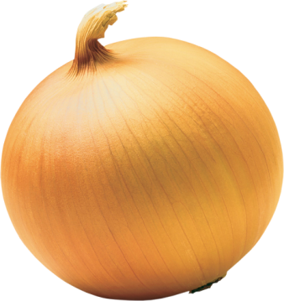
Does she like?
Onion

Slide 9
Onion
No, she doesn’t. It’s Yucky

Slide 10
Қосымша ереже!!!!!
Does your mother like
milk?
Yes, she does +
My mother likes milk
No, she doesn’t-
My mother doesn’t like milk
Milk
Does your father like
fish?
Fish

Slide 11
New words. Жаңа сөздер.
Hungry (хангри) – аш болу
Thirsty (сөсти) – шөлдеу
Does-даз
Doesn’t-дазнт

Slide 12
Language focus. Тілдік құрылым.
I’m hungry. Can I have some chicken? (айм хангри. Кән ай хәв сам чикен) – Менің қарным ашты. Кішкене тауық етін жесем бола ма?
I’m thirsty. Can I have some juice? (айм сөсти. Кән ай хәв сам джус) – Мен шөлдедім. Кішкене шырын ішсем бола ма?

Slide 13
https://www.youtube.com/watch?v=Ol7dOkqxDyYT
The Song
Task 1 Watch video and full fill the gaps with correct words
I’m hungry!
I’m so ____________!
I’m hungry!
Can I have some chicken?
Please, please, _________.
Can I have some _________?
I’m thirsty!
I’m so ____________!
I’m thirsty!
Can I have some juice?
Please, _________, please.
Can I have some juice?

Slide 14
Home work. Ex 3 p 55 AB The video task
To learn by heart the new words.
Жаңа сөздерді жаттау.

