Slide 1
The 30th of April Uniforms across the world

Slide 2
The learning objectives of the lesson:
7.L6 deduce meaning from context with little support in extended talk on a limited range of general and curricular topics
7.R5 deduce meaning from context in short texts on a growing range of familiar general and curricular topics

Slide 3
Open your Student’s Book at page 104

Slide 8
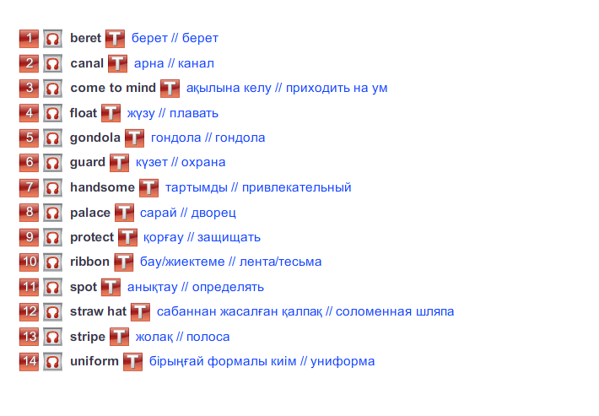

Slide 9
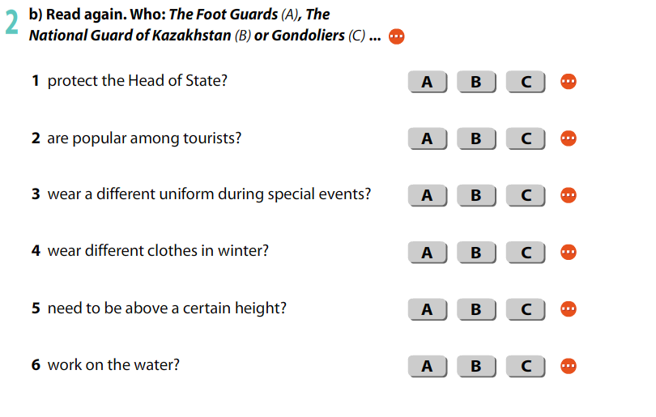

Slide 10
Send me your answers for my WhatsApp chat

Slide 11
Thank you for your attention!

