Slide 1
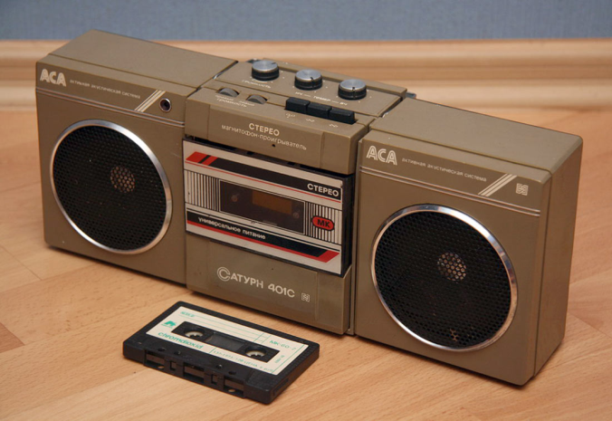
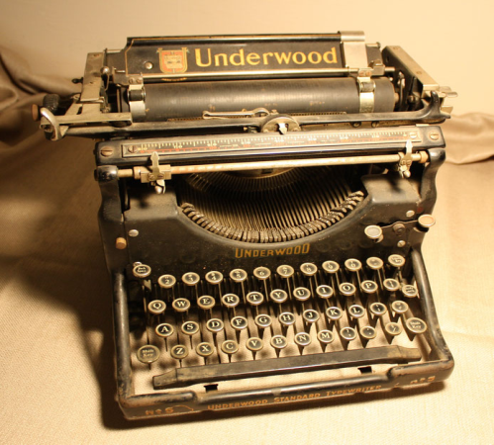
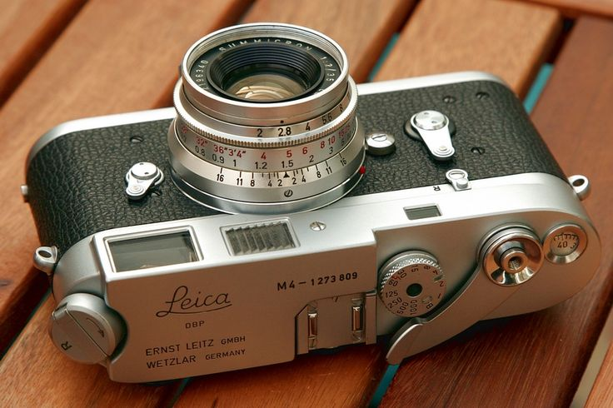
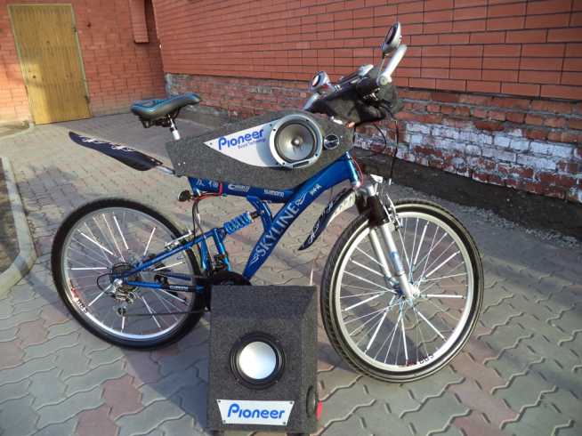
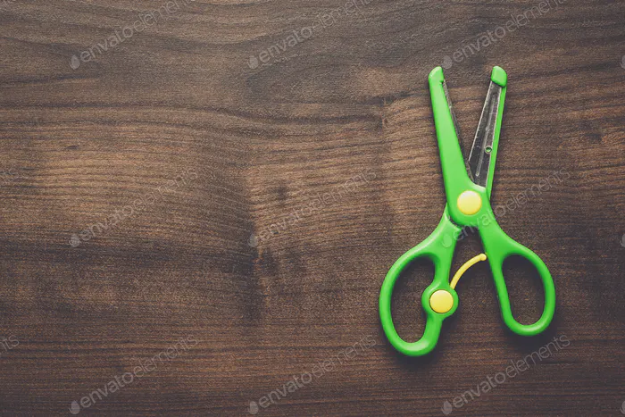
Theme: Slow machines
English
Grade: 4
Module 8. Machines

Slide 2
Aims:
To learn and talk about slow machines
Structures: Past Simple
Language in use: I would use … to …
Language focus:

Slide 3
Target vocabulary:
Photo booth Фото-будка
Coffee machine Кофе-машинасы
Computer Компьютер
Bicycle Велосипед
Cassette player Магнитофон
Typewriter Баспа машинкасы
Washing machine Кір жуу машинасы
Photo Фото
Press Басу
Button Кнопка
Handle Ручка

Slide 4
e.g. 1. A. I would use a photo booth to take a photo.
1. To take a photo 2. To go to school 3. To do your homework 4. To make a drink
Notes:
A photo booth a bicycle a computer a coffee machine

Slide 5
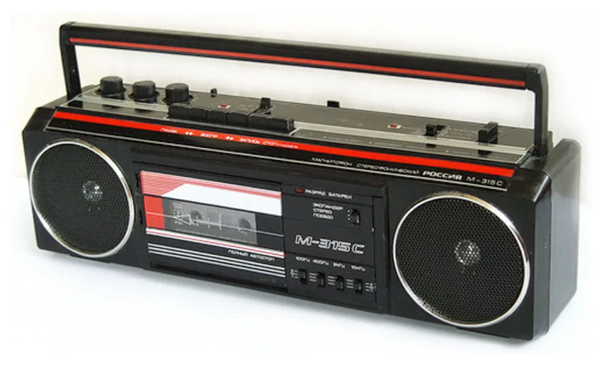
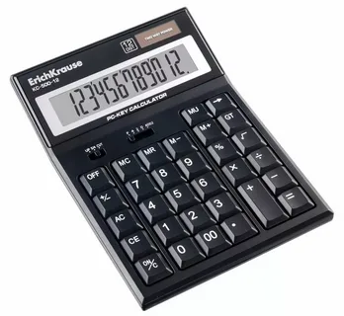
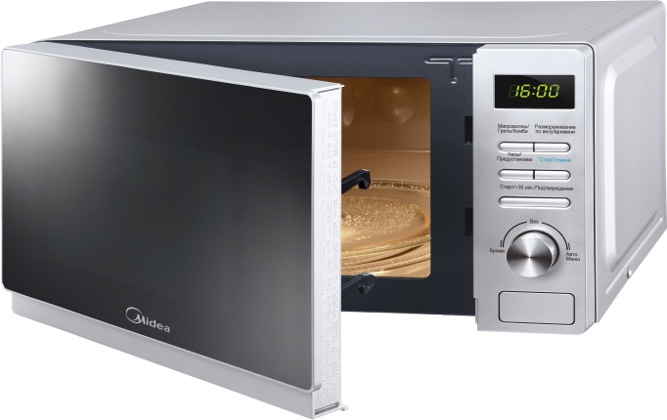
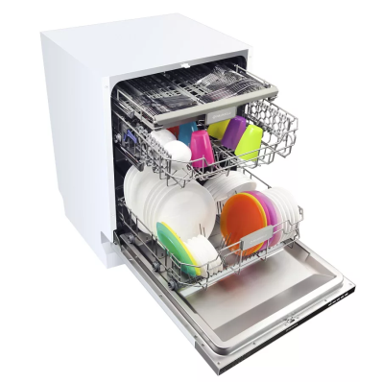
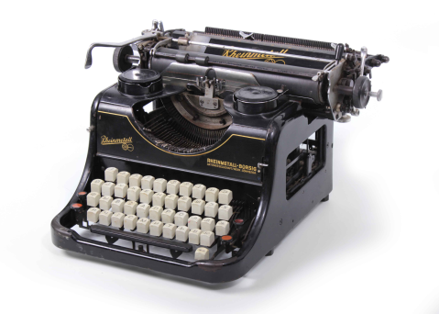
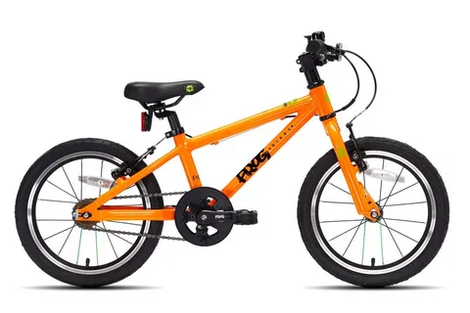
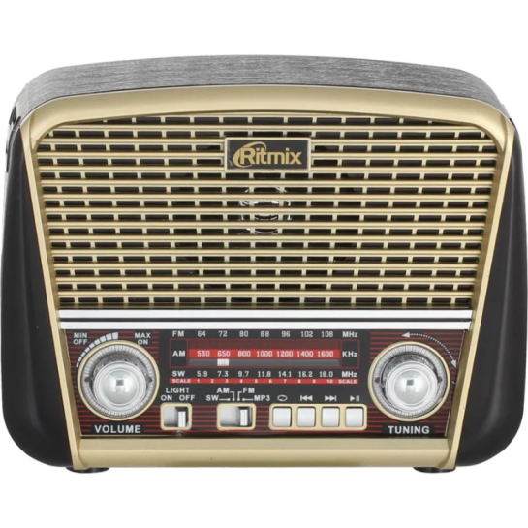
e.g. tablet (планшет) – fast machine
bicycle (велосипед) – slow machine

Slide 7
Here is a hint for you. All the verbs (except put) are regular.

Slide 8
Our lesson is over
See you soon

