Slide 1
Term 4 The 11th grade The theme: The Medical Wonders Медицинаның ғажайыбы
Students can …
… read and understand the text.
… write about kinds of surgery.
… answer the questions about health.
… use Future Simple about health.

Slide 2
MEDICINE
Medicine is the art and science of healing. It encompasses a range of health care practices evolved to maintain and restore health by the prevention and treatment of illness. Contemporary medicine applies health science, biomedical research, and medical technology to diagnose and treat injury and disease, typically through medication, surgery, or some other form of therapy.
The word medicine is derived from the Latin art medicine, meaning the art of healing.

Slide 3
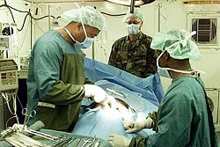
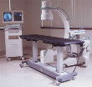
SURGERY
The earliest operations on the pericardium (the sac that surrounds the heart) took place in the 19th century and were performed by, among others, Francisco Romero, Dominique Jean Larrey, Henry Dalton, and Daniel Hale Williams.

Slide 4
Surgery has many subspecialties
e.g. general surgery, trauma surgery, cardiovascular surgery, neurosurgery, maxillofacial surgery, orthopedic surgery, otolaryngology, plastic surgery, oncologic surgery, vascular surgery, and pediatric surgery.

Slide 5
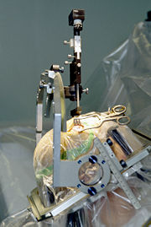
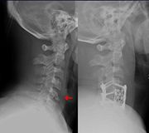
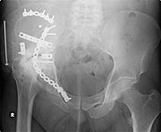
Neurosurgery
Neurosurgery is the surgical discipline focused on treating those central, peripheral nervous system and spinal column diseases amenable to surgical intervention.

Slide 6
Complete the sentences Сөйлемді жалғастыр
E.g. Orthopedic surgery or orthopedics is…
Pediatric surgery is …
An organ transplant is …
Vascular surgery is …
Cosmetic Surgery is …

Slide 7
Answer the questions Сұраққа жауап беру
What will be happen in our medicine in 2030?
What kinds of wonders will make our medicine in 2050?
What will we do to be healthy?

Slide 8
Self assessment Өзін – өзі бағалау 1. Read and understand the text. {1} 2. Write about kinds of surgery. {3} 3. Answer the questions about health. {3} 4. Use Future Simple about health. {3}

