Slide 1
Polyglot

Slide 2
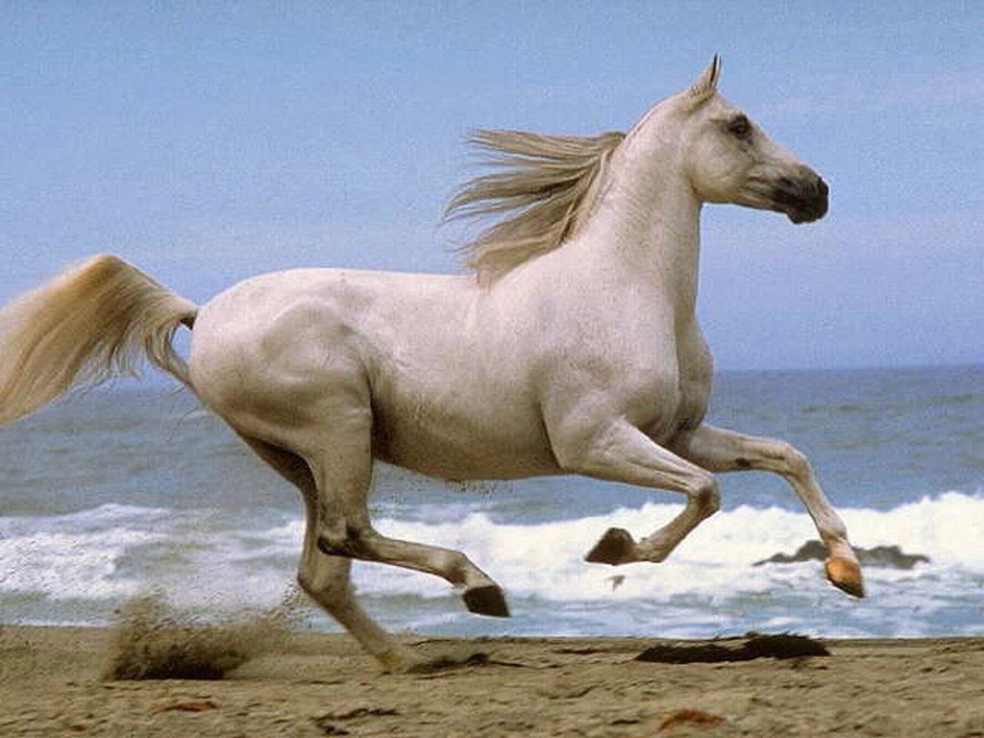
Who is the fastest?
Кім жүйрік?

Slide 3
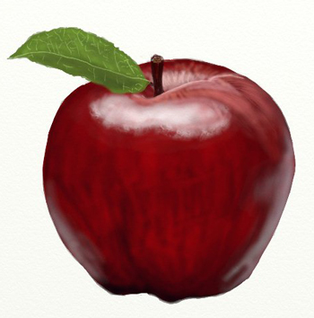
алма,яблоко, apple

Slide 4
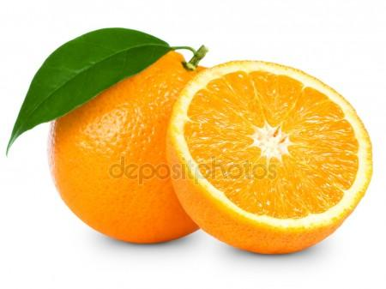
апельсин,апельсин,orange,

Slide 5
Үй, дом, house

Slide 6
қолшатыр, зонтик, umbrella

Slide 7
ит, собака,dog

Slide 8
қалам,
ручка,
pen

Slide 9
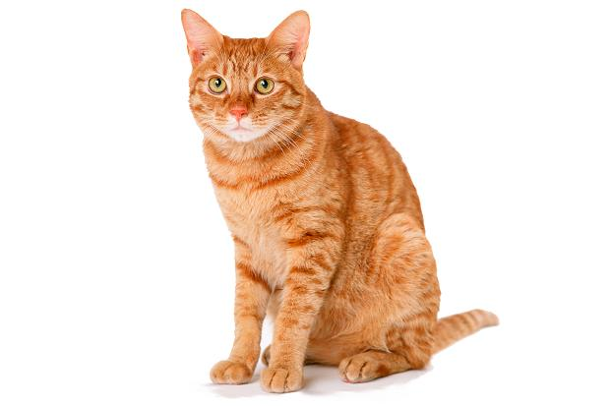
мысық,
кошка,
cat

Slide 10
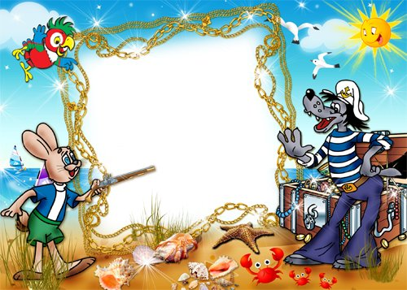
Who is the first?
Кім бірінші?

Slide 11
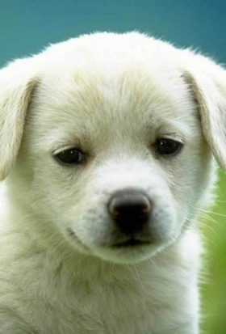
Aa
Cc
Dd
Ff
Bb
Dd
Hh
Zz

Slide 12
What colour is it?

Slide 13
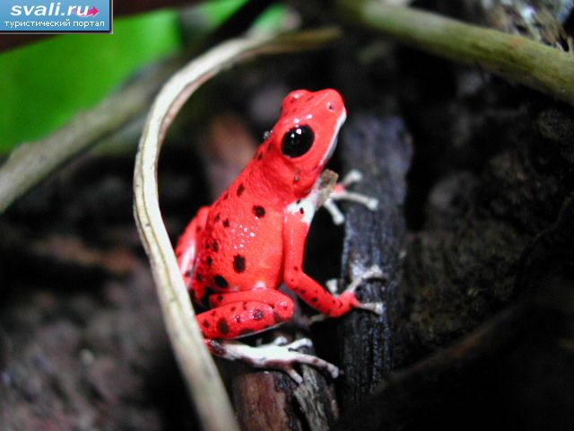
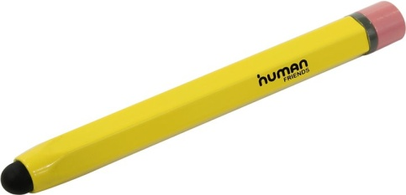
A frog green
A book red
A pen blue
A pencil yellow

Slide 14
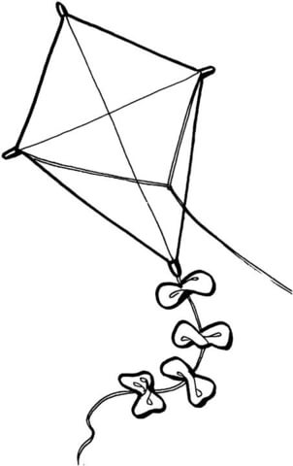
A pencil yellow
A book blue
An apple red
An umbrella purple
A kite blue
A pen green

Slide 15
Brother
Mummy
Sister
Daddy

Slide 16
Thank you for attention!

