Slide 1
The 23rd of January
Class work

Slide 2
Toys

Slide 3
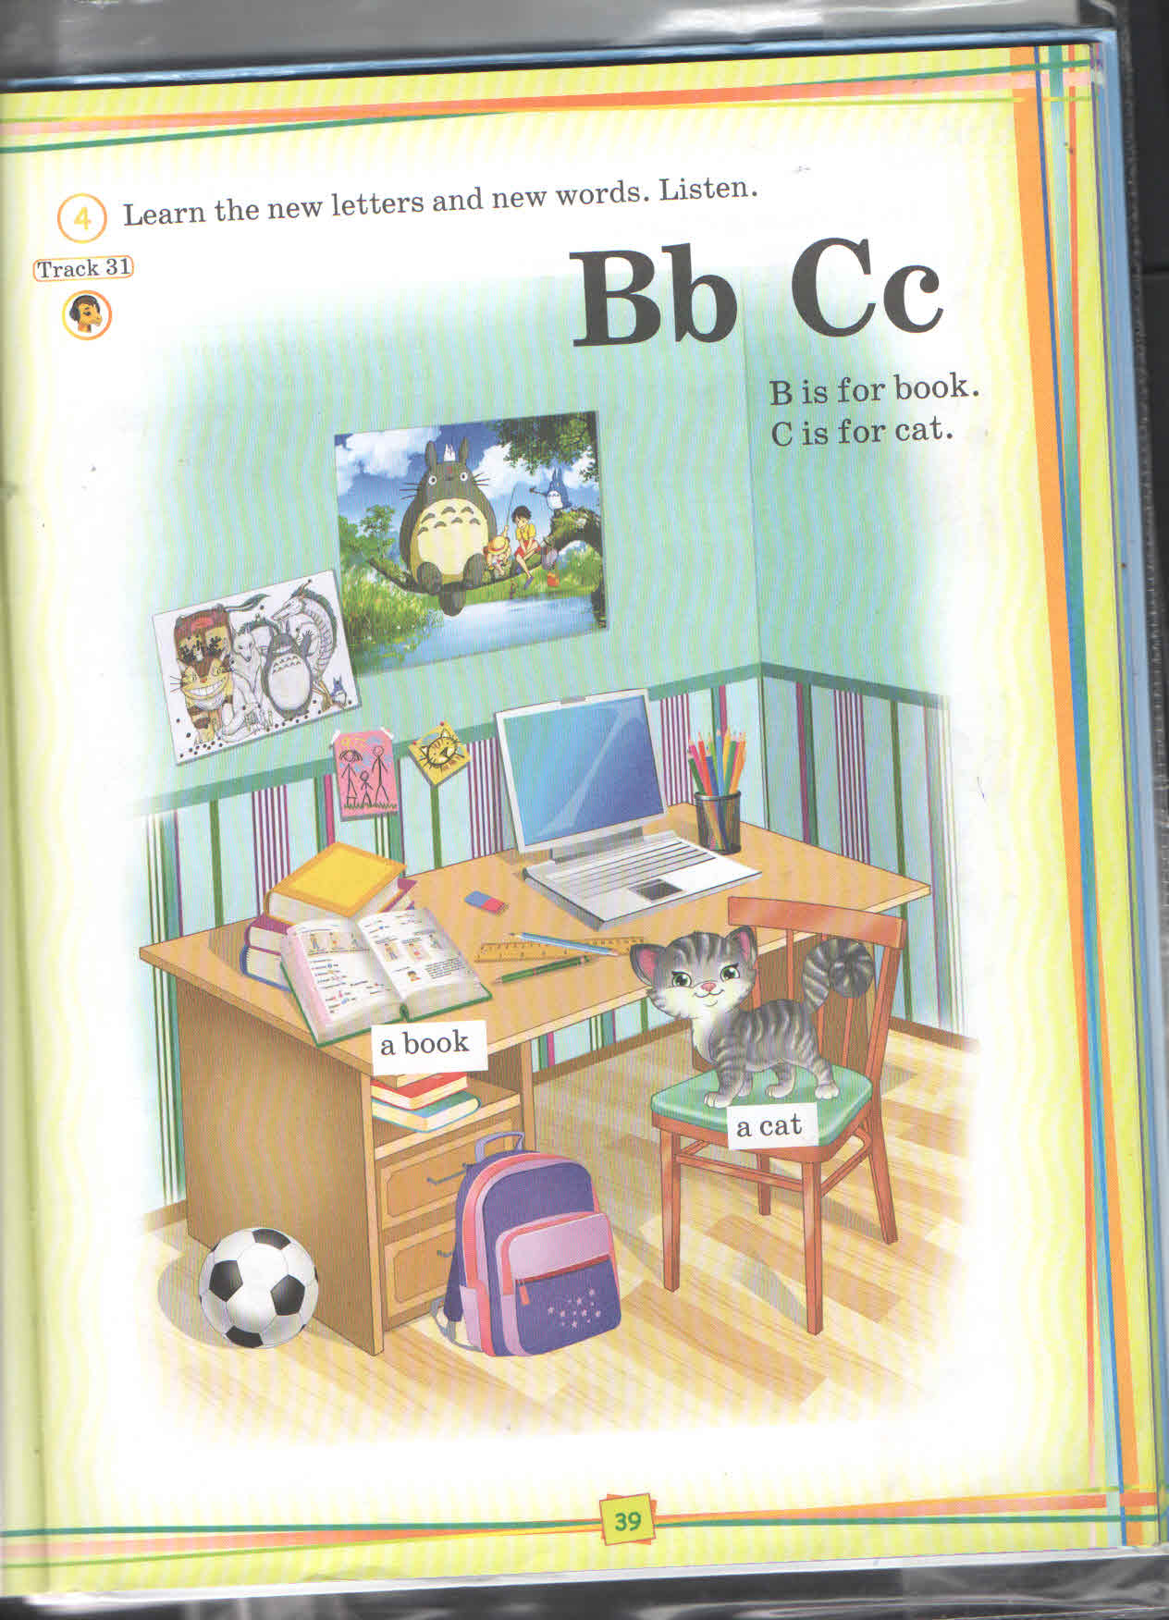

Slide 4
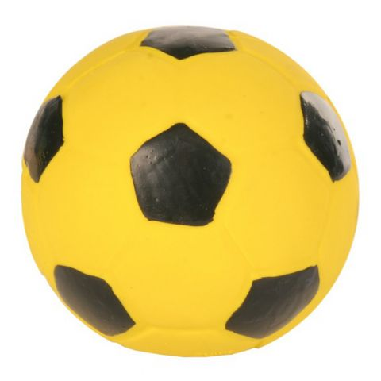
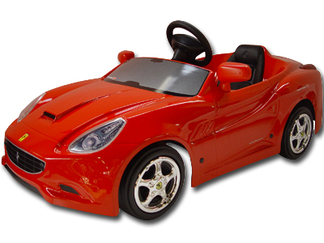
Is it a car?
No, it isn’t
Is it a car?
Yes, it is

Slide 5
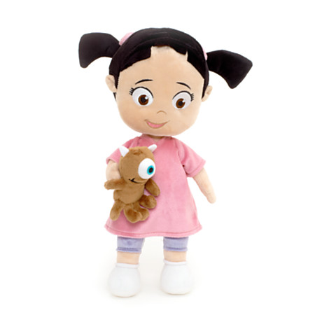
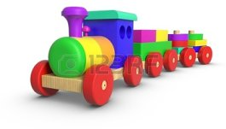
Is it a doll?
Yes, it is
Is it a ball?
No, it isn’t

Slide 6
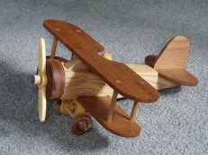
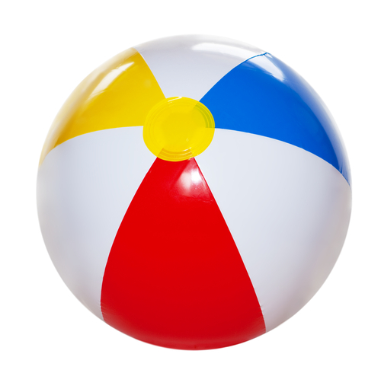
Is it a plane?
Yes, it is
Is it a ball?
Yes, it is

Slide 7
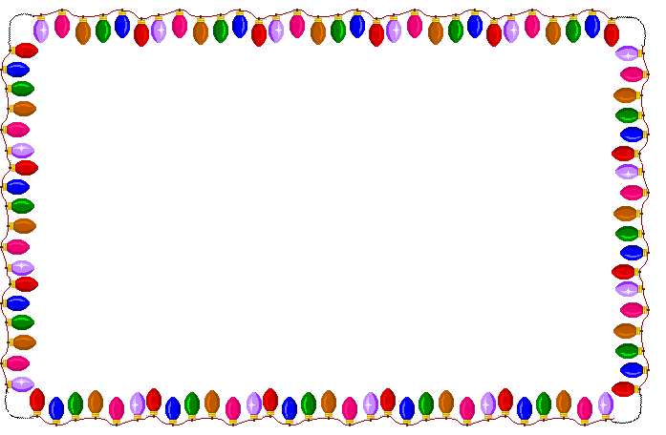

Slide 9
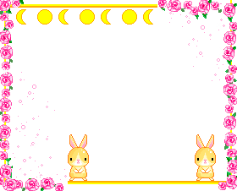
Yes, it is
No, it isn’t

Slide 10
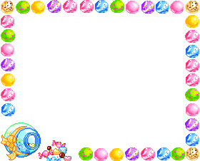
Yes, it is
No, it isn’t

Slide 12
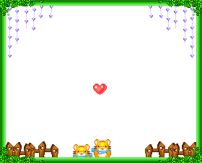

Slide 13
B
C
B

Slide 16
Home work

Slide 17
The lesson is over!
Good bye children!

