Slide 1
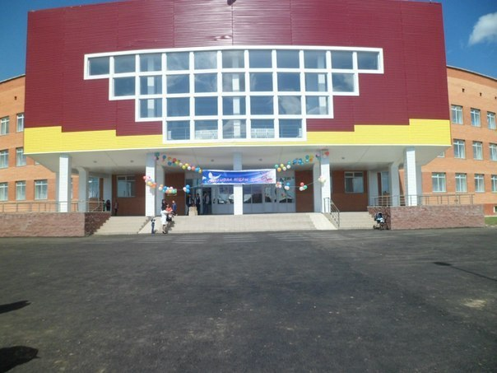
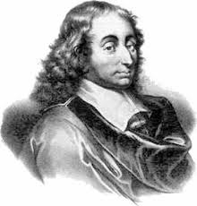
Pressure in liquids and gases. Pascal law 7th grade
№3 Talapker Secondary School Kaliyeva Aigul Kairgeldinovna Physics Teacher
Паскаль Блез
1623 -1662

Slide 2
Pressure is a value equal to the ratio of the force acting perpendicular to the surface to the area of ​​this surface. Pressure calculation formula Where p – pressure F - applied pressure force S - surface area / otherwise body support area /

Slide 3
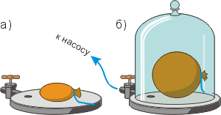
Pressure in liquids and gases of Pascal's Law Why does the ball increase its volume?
Conclusion:
The pressure of the gas on the walls of the vessel and placed in the gas the body is caused by the impact of gas molecules.

Slide 4
What does gas pressure depend on? Conclusion: Gas temperature From the volume occupied by the gas.

Slide 5
How do gases and liquids impart pressure? Pascal's law Liquids and gases transfer pressure in all directions equally.

Slide 6
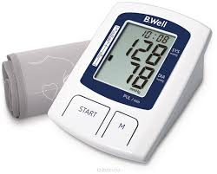
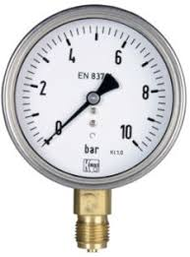
Pressure units Pa (Pascal) 1 Pa is the pressure that the 1H force produces, acting on a surface of 1 m2, perpendicular to this surface
Tanometr
Multiple and long units:
1 kPa = 1000 Pa 1Pa = 0.001 kPa
1 MPa = 1000000 Pa 1 Pa = 0.000001 MPa
1 hPa = 100 Pa 1 Pa = 0.01 hPa
Manometr

Slide 7
Fluid pressure calculation

Slide 8
Exercises
The DT-75M tracked tractor with a weight of 6610 kg has a reference area of ​​both tracks of 1.4 m2. What pressure does the tractor apply to the soil?
Given
m= 6610 kg
S= 1,4 m²
р = ?
Answer: P=46 270Pa

Slide 9
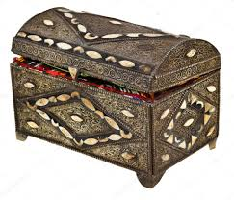
1
Complete tasks:
2
3

Slide 10
1.If you fully understand the topic then pick up a green apple 2.If you’ve half understood the topic of a lesson then pick up a yellow apple 3. If you do not understand the topic of the lesson then pick up a red apple

