Slide 1
Topic Cellular Respiration

Slide 3
You will:
compare the processes of aerobic and anaerobic respiration, using chemical reactions.

Slide 4
STQ
Oxygen is necessary for cell survival. What happens to the oxygen when it reaches cells?

Slide 5
Key terms
Aerobic respiration - the process of breaking down organic molecules using oxygen;
Anaerobic respiration - the process of breaking down organic molecules without oxygen;
Cellular respiration - the process of breaking down organic molecules producing energy.

Slide 6
Types of Cellular Respiration
Aerobic (“with air”) aero = air
Requires OXYGEN
More efficient, many ATP produced
Anaerobic (“without air”)
Does NOT require OXYGEN
Less Efficient, fewer ATP produced

Slide 7
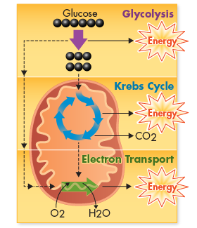
Steps to Cellular Respiration
Aerobic
1. Glycolysis
2. Krebs Cycle
3. Electron Transport Chain
Anaerobic
1. Glycolysis
2. Fermentation

Slide 8
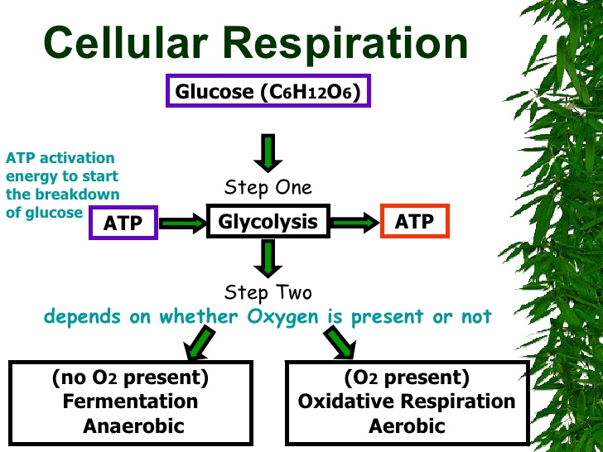
Cellular respiration is the process of breaking down food molecules to obtain energy and store it in the form of adenosine triphosphate (ATP) molecules.

Slide 9
Terminologia
aerobic respiration - аэробты тыныс алу / аэробное дыхание; alcoholic fermentation - спирттік ашу / спиртовое брожение; anaerobic respiration - анаэробты тыныс алу / анаэробное дыхание; barrel - бөшке / бочка;
burning - жану / сжигание;
cellular respiration - жасушалық тыныс / клеточное дыхание; consequently - тиісінше / следовательно;
ethanol - этанол;
facultative anaerobes - факультативті анаэробтар / факультативные анаэробы;
lactic acid - сүт қышқылы / молочная кислота;
lactic acid fermentation - сүтқышқылды ашу / молочнокислое брожение; obligate anaerobes - облигатты анаэробтар / облигатные анаэробы;
to release - шығару / выделять.

Slide 11
Facts
Alcohol is a waste product of yeast. Grapes are crushed and put into the barrel. Then yeasts are added, and the barrel is closed. Yeasts break down glucose in grapes and produce alcohol.
Some bacteria can live with and without oxygen. They are called facultative anaerobes. Some organisms cannot live with oxygen. They die if oxygen is present. These organisms are called obligate anaerobes.

Slide 12
Worksheet

Slide 14
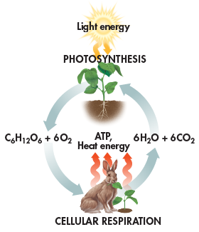
Comparing Photosynthesis and Cellular Respiration
Photosynthesis and cellular respiration are opposite processes.
The energy flows in opposite directions.
Photosynthesis “deposits” energy, and cellular respiration “withdraws” energy.
Reactants of cellular respiration are the products of photosynthesis.
Reactants of photosynthesis are the products of cellular respiration
= Biochemical Pathways.

Slide 15
Test

Slide 17
Remember your homework .
1.What is the main function of cellular respiration?
2.Why most of big animals and plants use aerobic respiration instead of anaerobic?
3.Where can anaerobic organisms live?

